Slide 1
Chapter 5: CPU Scheduling

Slide 2
Chapter 5: CPU Scheduling
Basic Concepts
Scheduling Criteria
Scheduling Algorithms
Thread Scheduling
Multi-Processor Scheduling
Real-Time CPU Scheduling
Operating Systems Examples

Slide 3
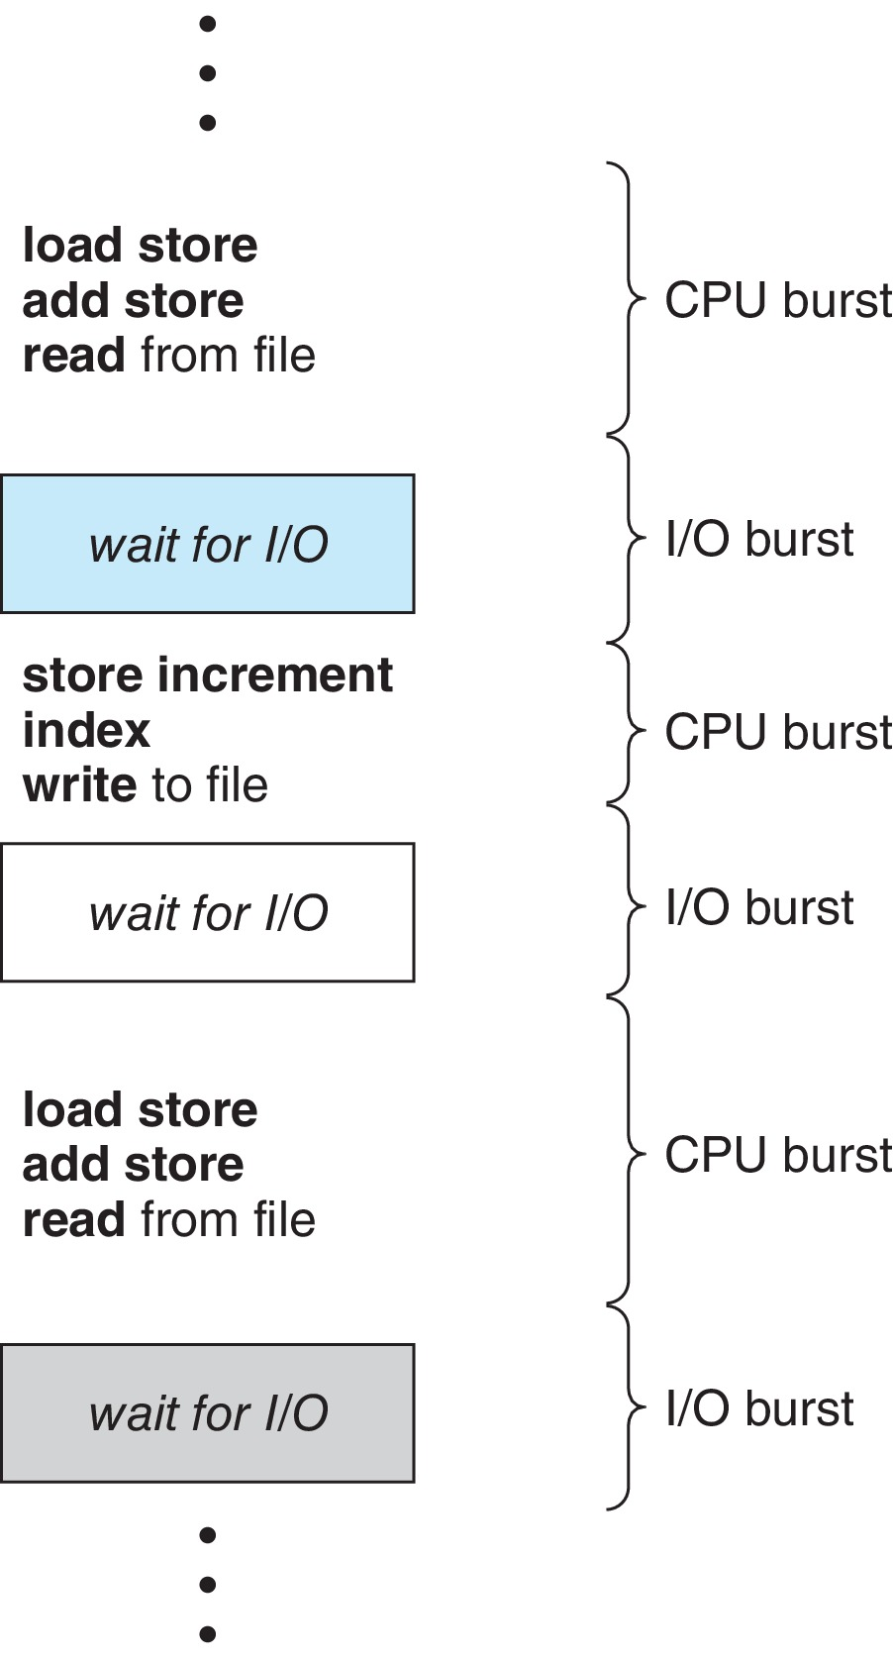
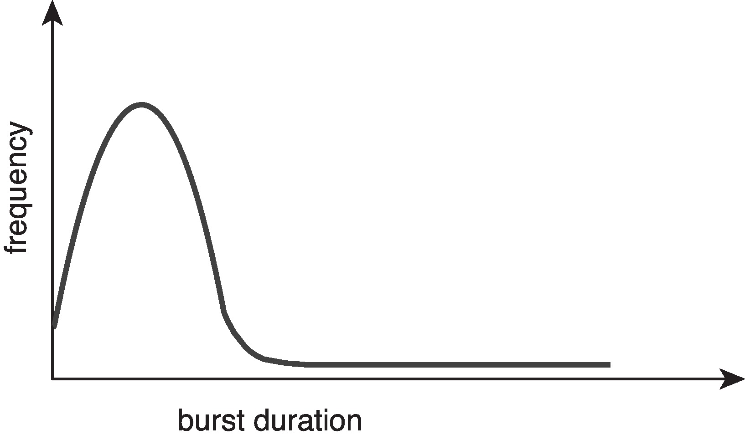
Basic Concepts
Purpose of multiprogramming: maximum CPU utilization
CPU–I/O Burst Cycle
Process execution consists of a cycle of CPU execution and I/O wait
CPU burst followed by I/O burst
CPU burst distribution is of main concern:
a large number of short CPU bursts and
a small number of long CPU bursts.

Slide 4
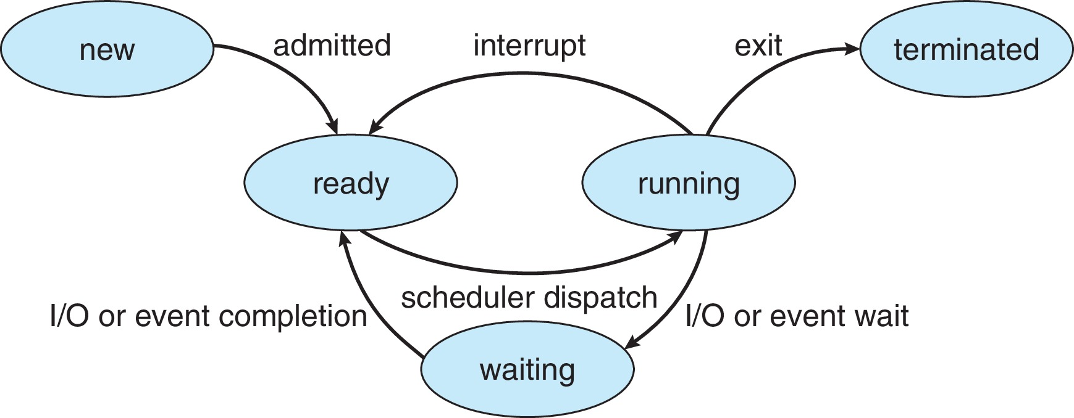
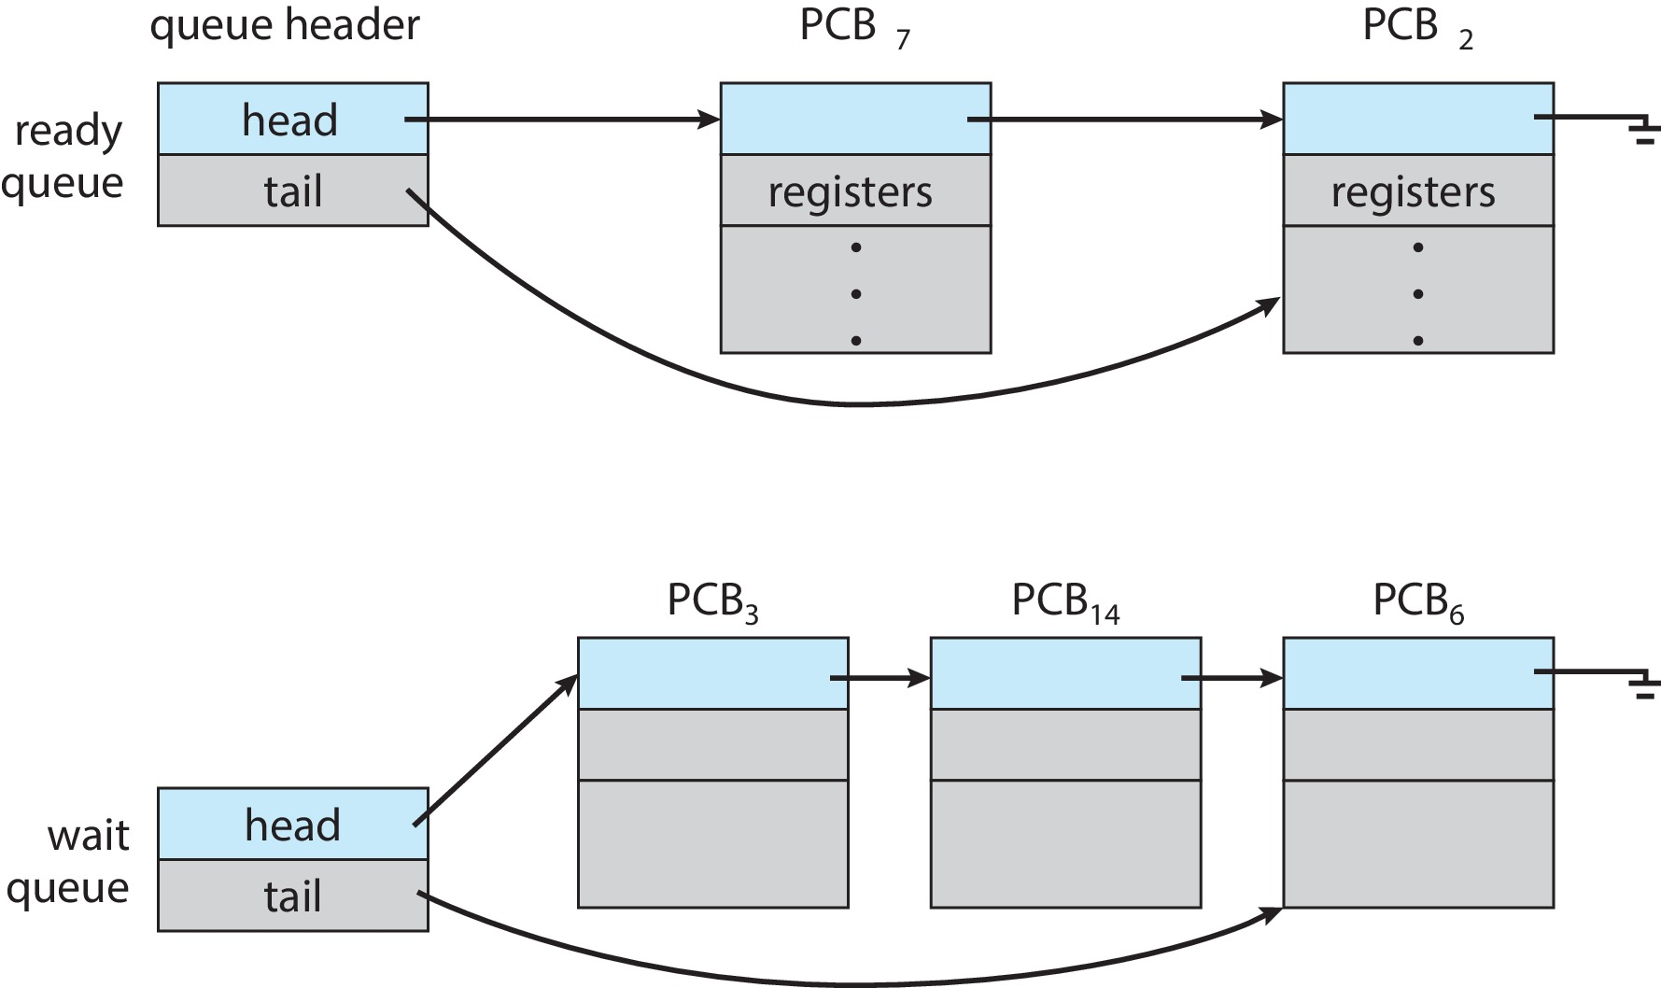
Process State Transition

Slide 5
CPU Scheduler
The CPU scheduler (CPU 调度程序) selects a process from the processes in ready queue, and allocates the CPU to it
Ready queue may be ordered in various ways
CPU scheduling decisions may take place when a process
switches from running to waiting state (non-preemptive 自愿离开CPU)
Example: the process does an I/O system call.
switches from running to ready state (preemptive 强占)
Example: there is a clock interrupt.
switches from waiting to ready (preemptive)
Example: there is a hard disk controller interrupt because the I/O is finished.
terminates (non-preemptive 自愿离开CPU)

Slide 6
CPU Scheduler
Scheduling under 1 and 4 is non-preemptive (非强占的，decided by the process itself)
All other scheduling is pre-emptive (强占的，decided by the hardware and kernel)
Preemptive scheduling can result in race conditions（will introduced in chapter 6） when data are shared among several processes
Some considerations in pre-emptive scheduling
Access to shared data
Preemption issue while CPU is in kernel mode
How to handle interrupts during crucial OS activities

Slide 7
Multilevel Queue
Ready queue is partitioned into separate queues, e.g.:
foreground (interactive 交互processes)
background (batch 批处理 processes)
Process permanently in a given queue (stay in that queue)
Each queue has its own scheduling algorithm:
foreground – RR
background – FCFS
Scheduling must be done between the queues:
Fixed priority scheduling
Each queue has a given priority
High priority queue is served before low priority queue
Possibility of starvation
Time slice
Each queue gets a certain amount of CPU time

Slide 8
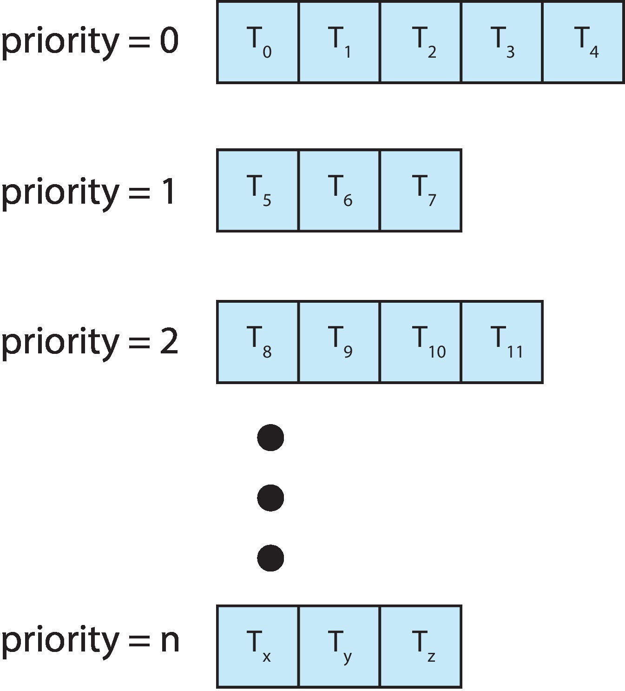
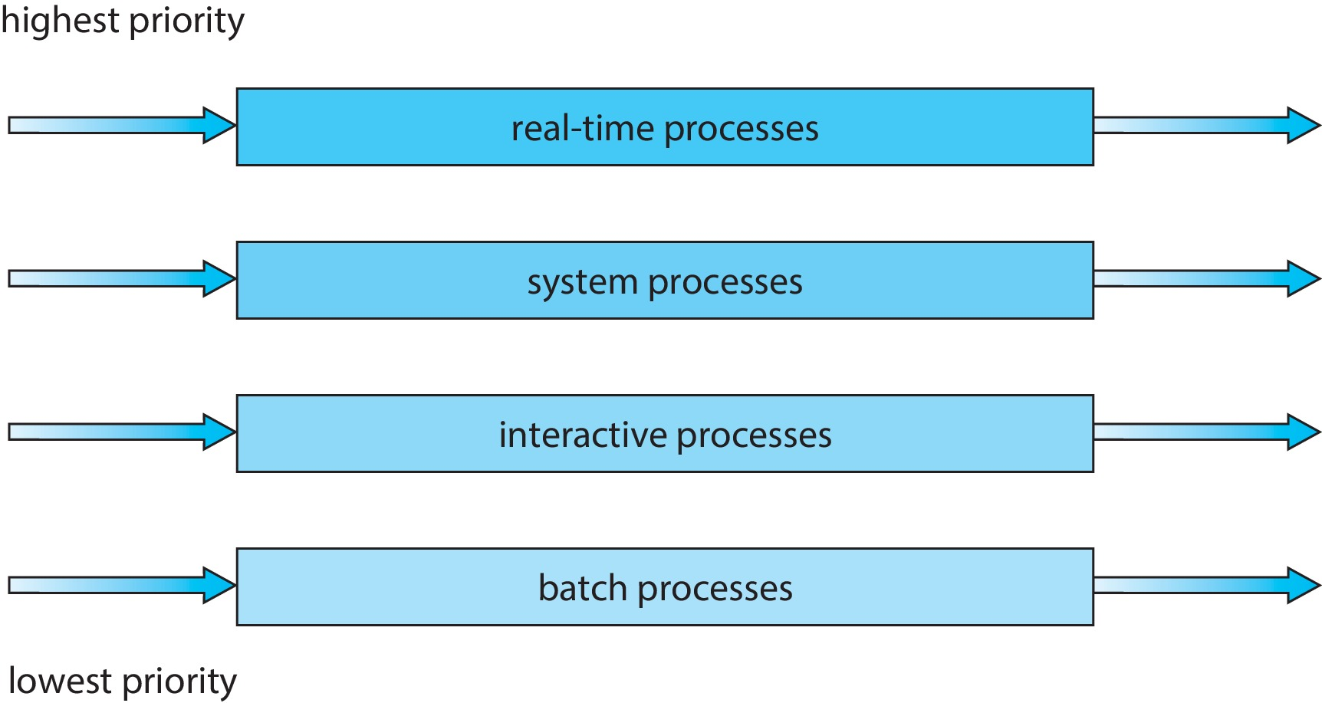
Multilevel Queue
With priority scheduling, for each priority, there is a separate queue
Schedule the process in the highest-priority queue!
Prioritization based upon process type

Slide 9
Multilevel Feedback Queue
A process can move between the various queues;
aging can be considered in this way (prevent starvation)
advantage: prevent starvation
The multilevel feedback queue scheduler
the most general CPU scheduling algorithm
defined by the following parameters:
number of queues
scheduling algorithms for each queue
Policies on moving process between queues
when to upgrade a process
when to demote (降级) a process
which queue a process will enter when that process needs service

Slide 10
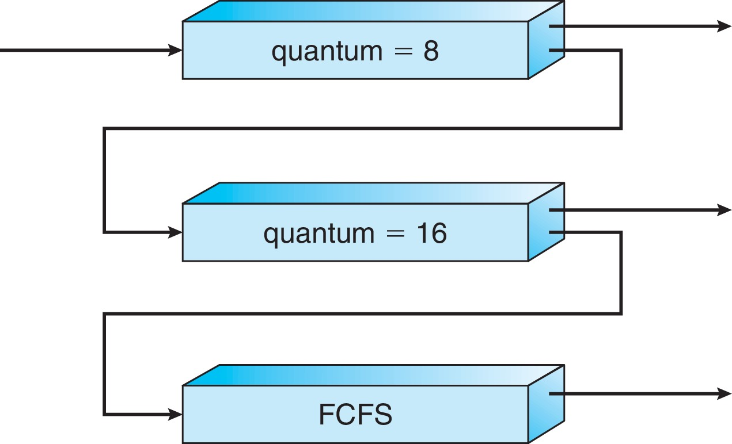
Example of Multilevel Feedback Queue
Three queues:
Q₀ – RR with time quantum 8 milliseconds
Q₁ – RR with time quantum 16 milliseconds
Q₂ – FCFS
FCFS+RR
FCFS+RR
Scheduling
A new job enters queue Q₀ which is served FCFS
When it gains CPU, job receives 8 milliseconds
If it does not finish in 8 milliseconds, job is moved to queue Q₁
At Q₁ job is again served FCFS and receives 16 additional milliseconds
If it still does not complete, it is preempted and moved to queue Q₂ where it runs until completion but with a low priority

Slide 11
Multiple-Processor Scheduling – Load Balancing
If Symmetric multiprocessing needs to keep all CPUs loaded for efficiency,
Load balancing attempts to keep workload evenly distributed
Push migration – periodic task checks load on each processor, and pushes tasks from overloaded CPU to other less loaded CPUs
Pull migration – idle CPUs pulls waiting tasks from busy CPU
Push and pull migration need not be mutually exclusive
They are often implemented in parallel on load-balancing systems.

Slide 12
Multiple-Processor Scheduling – Processor Affinity
Processor affinity
When a thread has been running on one processor, the cache contents of that processor stores the memory accesses by that thread, i.e., a thread has affinity for a processor
Load balancing may affect processor affinity
a thread may be moved from one processor to another to balance loads,
that thread loses the contents of what it had in the cache of the processor it was moved off
Soft affinity – the operating system attempts to keep a thread running on the same processor, but no guarantees.
Hard affinity – allows a process to specify a set of processors it may run on.
The kernel then never moves the process to other CPUs, even if the current CPUs have high loads.

Slide 13
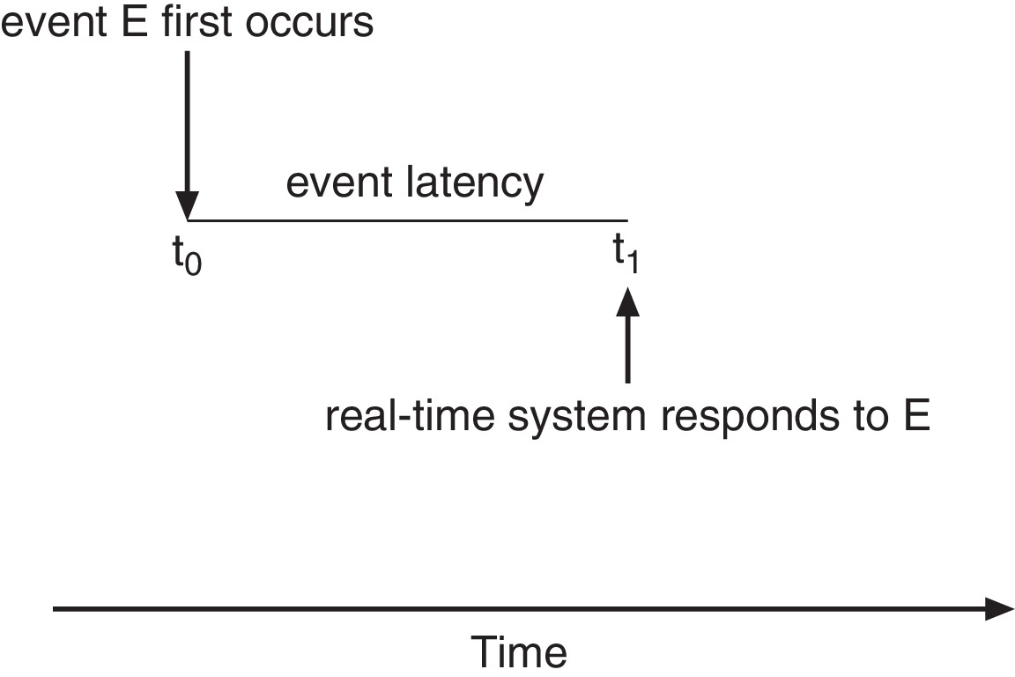
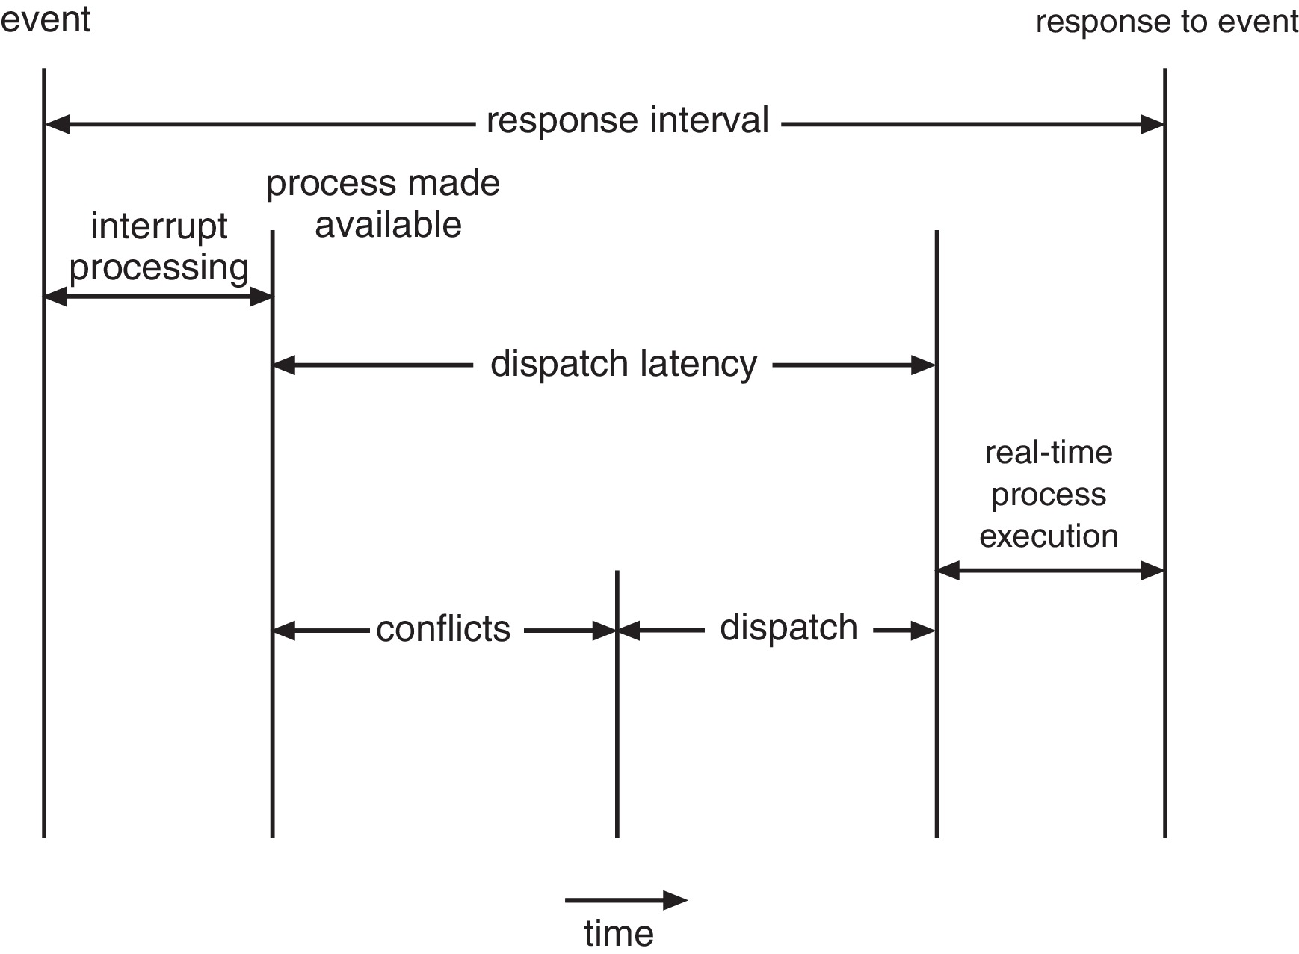
Real-Time CPU Scheduling
Event latency – the amount of time that elapses from when an event occurs to when it is serviced.
Two types of latencies affect performance
Interrupt latency – time from arrival of interrupt to start of kernel interrupt service routine (ISR) that services interrupt
Dispatch latency(调度延迟) – time for scheduler to take current process off CPU and switch to another

Slide 14
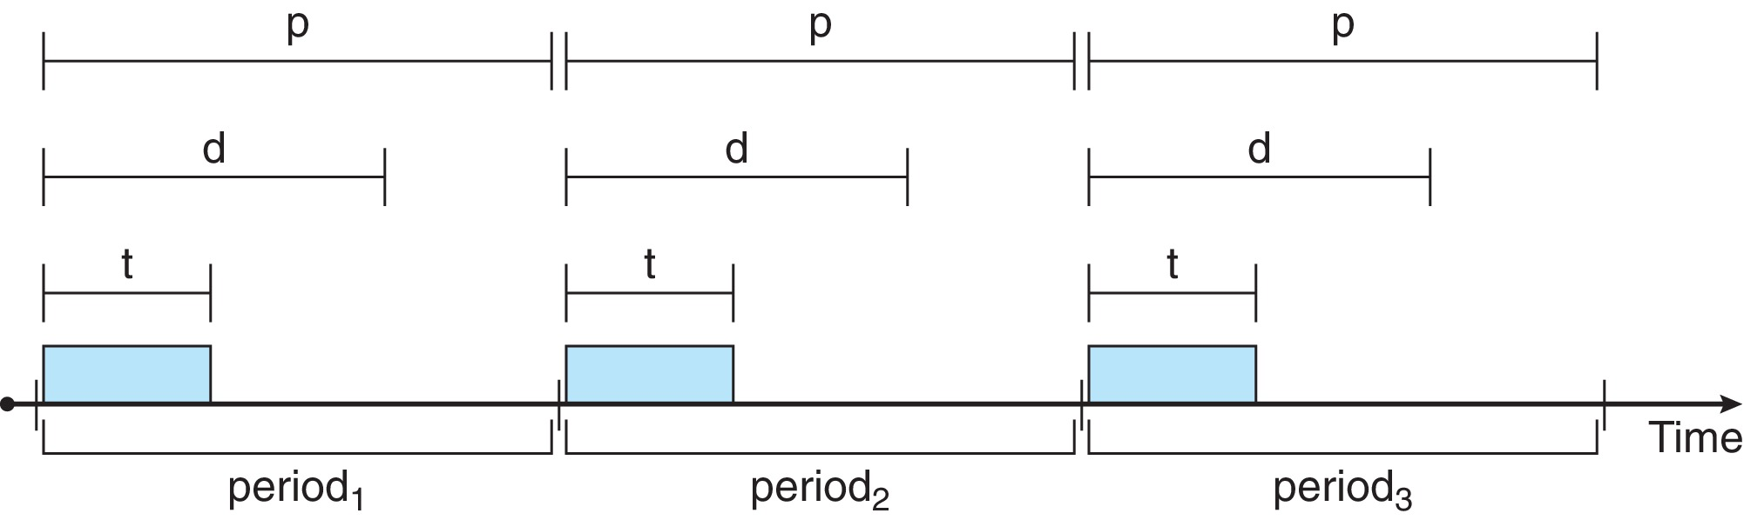
Priority-based Scheduling
For real-time scheduling, scheduler must support preemptive, priority-based scheduling
But only guarantees soft real-time
For hard real-time, must also provide ability to meet deadlines
Processes have new characteristics: periodically require CPU at constant intervals
Has processing time t, deadline d, period p
0 ≤ t ≤ d ≤ p
Rate of periodic task is 1/p

Slide 15
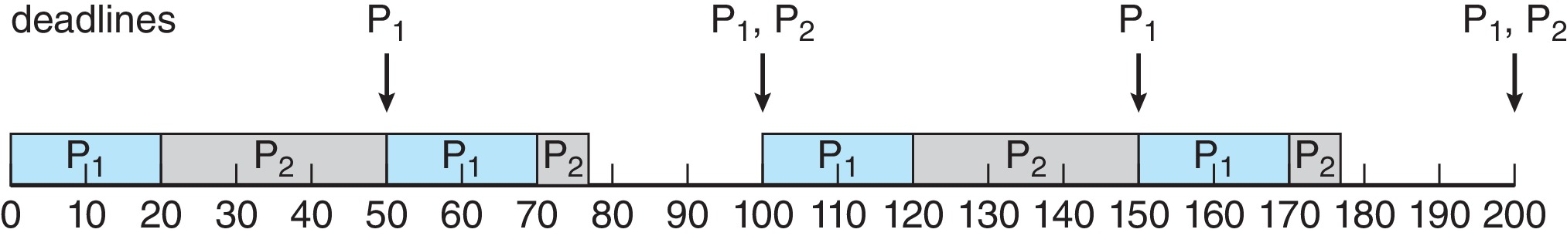
Rate Monotonic Scheduling
A priority is assigned based on the inverse of its period
Shorter periods = higher priority
Longer periods = lower priority
In the following example, P₁ is assigned a higher priority than P₂.
P₁ needs to run for 20 ms every 50 ms. t = 20, d = p = 50
P₂ needs to run for 35 ms every 100 ms. t = 35, d = p = 100
Assume deadline d = p

Slide 16
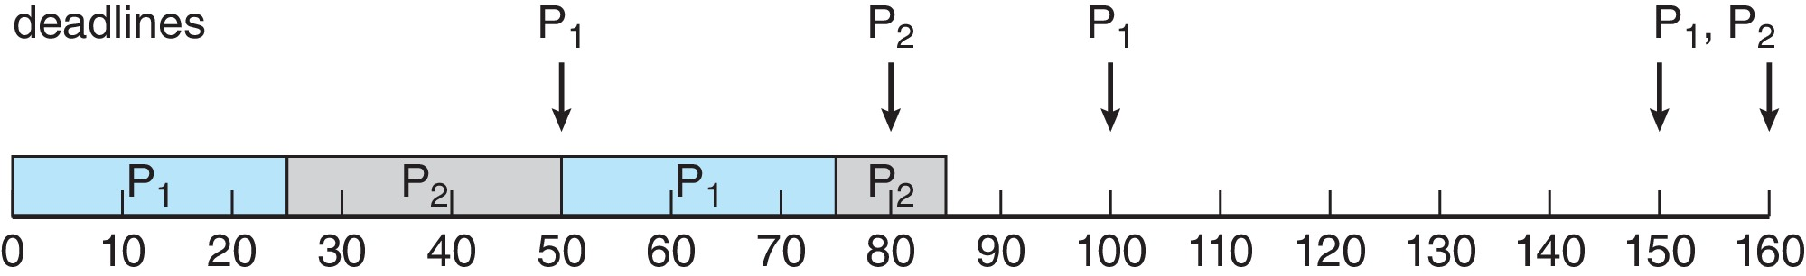
Missed Deadlines with Rate Monotonic Scheduling
Example:
P₁ needs to run for 25 ms every 50 ms. t = 25, d = p = 50
P₂ needs to run for 35 ms every 80 ms. t = 35, d = p = 80
Process P₂ misses its deadline at time 80 ms.
Observation: if P₂ is allowed to run from 25 to 60 and P₁ then runs from 60 to 85 then both processes can meet their deadline.
So the problem is not a lack of CPU time, the problem is that rate monotonic scheduling is not a very good algorithm.
5
P2:25
P2:needs 10

Slide 17
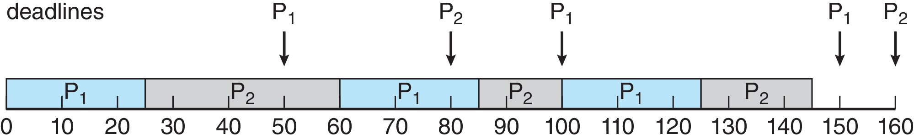
Earliest Deadline First Scheduling (EDF)
Priorities are assigned according to deadlines:
the earlier the deadline, the higher the priority;
the later the deadline, the lower the priority.
Example:
P₁ needs to run for 25 ms every 50 ms.
P₂ needs to run for 35 ms every 80 ms.
This is the scheduling algorithm many students use when they have multiple deadlines for different homework assignments!

Slide 18
Chapter 6 & 7: Process Synchronization

Slide 19
Process Synchronization
Background
The Critical-Section Problem
Peterson’s Solution
Synchronization Hardware
Mutex Locks
Semaphores
Classic Problems of Synchronization
Monitors

Slide 20
Background
Processes can execute concurrently
May be interrupted at any time, partially completing execution
Concurrent access to shared data may result in data inconsistency
An example
The variable counter in an implementation of producer-consumer
item next_produced;
while (true) { /* produce an item in next_produced */
while (counter == BUFFER_SIZE) //buffer is full
;/* do nothing, such as create data */
buffer[in] = next_produced;
in = (in + 1) % BUFFER_SIZE;
counter++;
}
item next_consumed;
while (true) {
while (counter == 0) //buffer is empty
; /* do nothing */
next_consumed = buffer[out];
out = (out + 1) % BUFFER_SIZE;
counter--; //total # of items in the buffer
/* consume the item in next_consumed */
}

Slide 21
Race Condition
counter++ could be implemented as register1 = counter register1 = register1 + 1 counter = register1
counter-- could be implemented as register2 = counter register2 = register2 - 1 counter = register2
Consider this execution interleaving with “counter = 5” initially:
S0: producer execute register1 = counter
S1: producer execute register1 = register1 + 1
S2: consumer execute register2 = counter
S3: consumer execute register2 = register2 – 1
S4: producer execute counter = register1
S5: consumer execute counter = register2
{register1 = 5} {register1 = 6} {register2 = 5} {register2 = 4} {counter = 6 } {counter = 4}
Race condition:
several processes access and manipulate the same data concurrently
outcome depends on which order each access takes place.

Slide 22
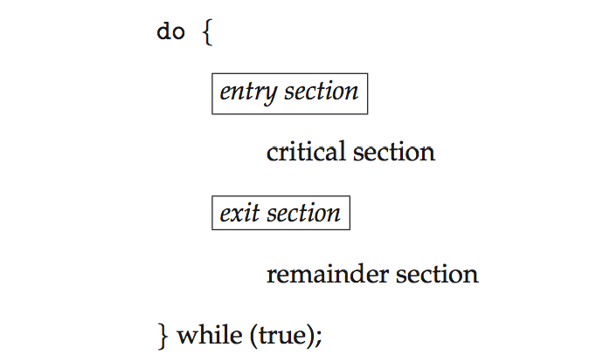
Critical Section Problem
Consider system of n processes {p₀, p₁, … p_{n-1}}
Several processes may be changing common variables, updating table, writing file, etc.
critical section
The segment of code in a process that modifies these shared variables, tables, files
When one process is in critical section, other process should not enter their critical sections for these shared data .

Slide 23
Critical Section
General structure of process P_{i}
Ask for permission
Protect this section
Do sth in order to allow other processes to enter critical section

Slide 24
Critical Section Problem
Critical section problem is to design a protocol （协议） that the processes can use to cooperate
Process with critical section should follow the following steps
execute entry section to ask for permission
then execute critical section,
execute exit section to allow other process to enter critical section
then execute remainder section

Slide 25
Solution to Critical-Section Problem
A solution to the critical-section problem must satisfy three requirements:
Mutual Exclusion
If process P_{i} is executing in its critical section, then no other processes can be executing in their critical sections
Progress
If no process is executing in its critical section and if other processes want to enter critical section, one of them must be selected. They cannot be postponed indefinitely
Bounded Waiting
If a process has made a request to enter its critical section, then, before that request is granted, there is a bound to the times that others can enter critical section

Slide 26
Solution to Critical-Section Problem
Assumptions in the solution
each process executes at a nonzero speed
no concerning relative speed of the n processes
the load and store machine-language instructions are atomic (that is, cannot be interrupted)

Slide 27
Example: Solution to Critical-Section Problem
Example: two students want to eat from the same plate of food using one spoon.
1. Mutual Exclusion - If one student is eating using the spoon, then the other student must wait for the spoon to become available: the two students cannot both use the spoon at the same time! Otherwise the two students will end up fighting and breaking the plate of food (race condition).
2. Progress - If one student is not hungry and the other student wants to get the spoon to eat, then the other student must be able to take the spoon and eat: the student who is not hungry is not allowed to prevent the other student from taking the spoon and eating. Otherwise the other student will wait for ever and die from hunger.
3. Bounded Waiting - If one student is eating and the other student is waiting for the spoon, the first student is not allowed to put down the spoon on the table and immediately take it again to eat again: the student who puts down the spoon must allow the other student to take the spoon so that the other student can eat too. In other words, the two students must be nice with each other and not be selfish. Otherwise the other student will wait for ever and die from hunger.

Slide 28
Critical Section: Solution 1
turn’s value is initialized to be either i or j
Pi | Pj
do { while (turn == j); //entry section critical section //turn is i turn = j; //exit section remainder section } while (true); | do { while (turn == i); //entry section critical section // turn is j turn =i; //exit section remainder section } while (true);
Mutual Exclusion： Yes
Progress： No
Bounded waiting： Yes

Slide 29
Detailed Explanation on Example 1
Mutual Exclusion: Yes - If process P_{i} is inside the critical section then P_{j} cannot enter the critical section because of the while loop in the entry section that forces P_{j} to wait for P_{i} to exit the critical section.
And vice-versa: if P_{j} is inside the critical section then P_{i} must wait in the entry section until P_{j} exits the critical section.
What happens if both processes try to enter the critical section at the exact same time? The shared turn variable can only store i or j, but not both, so the test of the while loop will only be false for one of the two processes, not for both, and only one process will be able to enter the critical section, the other process will have to wait in the entry section.
Which process enters the critical section first is then determined by the initial value of the turn variable.

Slide 30
Detailed Explanation on Example 1 (Continue)
Progress: No – If the turn variable contains the value j (for example) and P_{i} wants to enter the critical section and P_{j} does not want to enter the critical section (assuming there is no do{}while loop around P_{j}’s code and P_{j} is busy doing something else) then P_{i} will wait for ever, even though P_{j} is not inside the critical section.
P_{i} can only enter the critical section after P_{j} has been in the critical section, and P_{j} can only enter the critical section after P_{i} has been in the critical section.
P_{i} → P_{j} → P_{i} → P_{j} → P_{i} → P_{j} → P_{i} →…
If P_{j} does not want to enter the critical section again then P_{i} is going to get stuck and wait for ever in the entry section for P_{j} to exit the critical section, which P_{j} is never going to do.
P_{i} → P_{j} → P_{i} → P_{i} again and gets stuck for ever.

Slide 31
Detailed Explanation on Example 1 (Continue)
Bounded Waiting: Yes - There is a bound of 1 time on the number of times that P_{j} (for example) is allowed to enter the critical section after P_{i} has made a request to enter its critical section and before that request is granted, because when P_{j} exits the critical section it changes the turn variable to be i, which then immediately allows P_{i} to enter the critical section.
Even if we assume that P_{j} is very fast and P_{i} is very slow (for example), it is not possible for P_{j} to beat P_{i} to the race and exit the critical section and immediately re-enter it again before P_{i} is allowed to take its turn inside the critical section.
In other words, it is not possible for P_{j} to prevent P_{i} from going into the critical section by going in and out of the critical section as fast as possible.
So P_{i} is guaranteed to be able to enter the critical section at some point in the future (right after P_{j} is finished) and will not have to wait for ever, even if P_{j} wants to re-enter the critical section all the time.

Slide 32
Peterson’s Solution
It is a classic software-based solution to the critical-section problem
Good algorithmic description of solving the problem
Solution for two processes by using two variables:
int turn; // indicates whose turn it is to enter the critical section.
Boolean flag[2] // indicate if a process is ready to enter the critical section.
flag[i] = true implies that process P_{i} is ready!
It is initialized to FALSE.

Slide 33
Algorithm for Process P_{i} & P_{j}
P_{i}
do {
flag[i] = true; //ready
turn = j; //allow P_{j} to enter
while (flag[j] && turn = = j);
critical section
flag[i] = false; //exit
remainder section
} while (true);
Ask for entry permission
Mutual Exclusion： Yes
Progress： Yes
Bounded waiting： Yes
P_{j}
do {
flag[j] = true; //ready
turn = i; //allow P_{i} to enter
while (flag[i] && turn = = i);
critical section
flag[j] = false; //exit
remainder section
} while (true);
Ask for entry permission

Slide 34
Synchronization Hardware
Software-based solutions (such as Peterson’s) are not guaranteed to work on modern computer architecture
Many systems provide hardware support for implementing the critical section code.
Uniprocessors – could disable interrupts
Currently running code would execute without preemption
too inefficient
Modern machines provide special atomic hardware instructions
Atomic = non-interruptible， the atomic hardware instruction will do the following work
Test memory word and set value
Swap contents of two memory words
E.g., test_and_set instruction in the next page

Slide 35
Atomic test_and_set Instruction
Definition:
boolean test_and_set (boolean *target)
{
boolean rv = *target;
*target = TRUE;
return rv:
}
The C code here is just to explain how the hardware instruction works.
This instruction is executed atomically by CPU as a single hardware instruction.
In practice, target is a pointer to the lock itself, shared by all the processes that want to acquire the lock.
If target if FALSE, the return value of rv is FALSE, means lock is FALSE (available), target’s new value is TRUE
If target is true, the return value of rv is TRUE, means lock is TRUE (locked)

Slide 36
Solution to Critical-section Problem Using Locks
do {
acquire lock
critical section
release lock
remainder section
} while (TRUE);
entry section
exit section
Use the idea of locking
Protecting critical regions via locks
A process that wants to enter the critical section must first get the lock.
If the lock is already acquired by another process, the process will wait until the lock becomes available.

Slide 37
Solution using test_and_set()
Shared Boolean variable lock, initialized to FALSE
Solution using test_and_set:
boolean test_and_set (boolean *target)
{
boolean rv = *target;
*target = TRUE;
return rv:
}
do { while (test_and_set(&lock))
; /* do nothing */
/* critical section */
lock = FALSE;
/* remainder section */
} while (true);
do {
acquire lock
critical section
release lock
remainder section
} while (TRUE);
When lock = true, keep while looping.
When lock = FALSE, process can enter the critical section
And set lock = TRUE, block other processes to enter.
After finish the critical section, reset lock = FALSE, to allow other processes to enter the critical section.
Mutual Exclusion： Yes
Progress： Yes
Bounded waiting： No

Slide 38
Bounded-waiting Mutual Exclusion with test_and_set
P_{i}
do { waiting[i] = true; key = true; while (waiting[i] && key)
key = test_and_set(&lock);
waiting[i] = false;
/* critical section */
j = (i + 1) % n;
while ((j != i) && !waiting[j])
j = (j + 1) % n;
if (j == i)
lock = false;
else
waiting[j] = false;
/* remainder section */
} while (true);
do {
acquire lock
critical section
release lock
remainder section
} while (TRUE);
Common data structures:
boolean waiting[n];
boolean lock;
These data structures are initialized to false.

Slide 39
Bounded-waiting Mutual Exclusion with test_and_set (Continue)
…
…
P1
Pi-1
Pi
Pi+1
Pn
Any process wait=true?

Slide 40
Bounded-waiting Mutual Exclusion with test_and_set (Continue)
P_{i}
P_{k}
do { waiting[i] = true; key = true; while (waiting[i] && key)
key = test_and_set(&lock);
waiting[i] = false;
/* critical section */
j = (i + 1) % n;
while ((j != i) && !waiting[j])
j = (j + 1) % n;
if (j == i)
lock = false;
else
waiting[j] = false;
/* remainder section */
} while (true);
do { waiting[k] = true; key = true; while (waiting[k] && key)
key = test_and_set(&lock);
waiting[k] = false;
/* critical section */
j = (k + 1) % n;
while ((j != k) && !waiting[j])
j = (j + 1) % n;
if (j == k)
lock = false;
else
waiting[j] = false;
/* remainder section */
} while (true);
Mutual exclusion: Yes
Progress: Yes
Bounded-waiting: Yes

Slide 41
Explanations on Three Reequipments for Slide 24
Mutual exclusion: Yes
Process P_{i} can enter its critical section only if either waiting[i] == false or key == false
If waiting[i] is false, that means, another process finished critical section and give the turn to process P_{i}
If key is false, that means, lock was false before run test_and_set.
If another process (e.g., P_{k}) in waiting to enter, it cannot enter. Because waiting[k] is true, and lock is true.
waiting[i] = true; key = true; while (waiting[i] && key)
key = test_and_set(&lock);
waiting[i] = false;

Slide 42
Bounded-waiting Mutual Exclusion with test_and_set
Progress: Yes
If P_{i} wants to enter the critical section, while other process do not want to enter, lock is false. So the test_and_set will return false.
Bounded waiting: Yes
If process P_{i} leaves the critical section, and another process (e.g. P_{k}) is waiting, the exit section in P_{i} will set waiting[k] to the false
j = (i + 1) % n;
while ((j != i) && !waiting[j])
j = (j + 1) % n;
if (j == i)
lock = false;
else
waiting[j] = false;
…
…
P1
Pi-1
Pi
Pi+1
Pn
Any process wait=true?

Slide 43
Semaphore（信号灯）
Semaphore is a synchronization tool
more sophisticated than mutex locks
Semaphore S: an integer variable
S can only be accessed via two atomic operations
wait() and signal()
Originally called P() and V()
wait(S) {
while (S <= 0)
; // busy wait
S--;
}
signal(S) {
S++;
}
release lock
acquire lock

Slide 44
Semaphore（信号灯）
P_{i}
Pj
do { wait(S);
/* critical section */
signal（S）
/* remainder section */
} while (true);
do { wait(S);
/* critical section */
signal（S）
/* remainder section */
} while (true);
wait(S) {
while (S <= 0)
; // busy wait
S--;
}
signal(S) {
S++;
}
release lock

Slide 45
sem_wait and sem_post
#include <semaphore.h>
sem_t *sem_mutex;
Normally used among different processes
int sem_wait(sem_t *sem);
int sem_post(sem_t *sem);
do {
acquire lock
critical section
release lock
remainder section
} while (true);
sem_wait(sem_mutex);
sem_post(sem_mutex);

Slide 46
Semaphore Usage
Counting semaphore – integer value can range over an unrestricted domain
Binary semaphore – integer value can range only between 0 and 1
Same as a mutex lock
Semaphore can be used to solve various synchronization problems
An example: Consider two processes P₁ and P₂ that require T₁ to happen before T_{2.} Solution:
semaphore synch;
synch = 0
P1:
T₁;
signal(synch);
P2:
wait(synch);
T₂;

Slide 47
Semaphore Implementation
Advantage
implementation code is short
Disadvantage：
Must guarantee that no two processes can execute the wait()and signal()on the same semaphore at the same time
S--， S++ in wait() and signal()
Thus, the implementation becomes the critical section problem where the wait and signal code are placed in the critical section
The solution now have busy waiting in critical section implementation
Both mutex lock and semaphore suffer from busy waiting.

Slide 48
Semaphore Implementation with no Busy waiting
With each semaphore there is an associated waiting queue
Each semaphore has:
an integer value
A queue of processes
Two operations:
block – place the process invoking the operation on the appropriate waiting queue
wakeup – remove one of processes in the waiting queue and place it in the ready queue
typedef struct{
int value;
struct process *list;
} semaphore;

Slide 49
Implementation with no Busy waiting (Cont.)
Again, C code is just for explanation:
No busy waiting
Busy waiting
wait(semaphore *S) {
S->value--;
if (S->value < 0) { //add this process to S->list;
block();//put in a waiting queue
}
}
signal(semaphore *S) {
S->value++;
if (S->value <= 0) { //remove a process P from S->list;
wakeup(P);//put in a ready queue
}
}
wait(S) {
while (S <= 0)
; // busy wait
S--;
}
signal(S) {
S++;
}
S: initial value 1
S->value: initial value 1

Slide 50
Classical Problems of Synchronization
Classical problems used to test newly-proposed synchronization schemes
Bounded-Buffer Problem
Readers-Writers Problem
Dining-Philosophers Problem

Slide 51
Problems with Semaphores
Deadlock and starvation are possible.
Incorrect use of semaphore operations:
signal (mutex) …. wait (mutex)
wait (mutex) … wait (mutex)
Omitting of wait (mutex) or signal (mutex) (or both)
It is the responsibility of the application programmer to use semaphores correctly.

Slide 52
Deadlock and Starvation
Let S and Q be two semaphores initialized to 1
P₀ P₁
wait(S); wait(Q);
wait(Q); wait(S);
... ...
signal(Q); signal(S);
signal(S); signal(Q);
Can cause starvation and priority inversion
Starvation – indefinite blocking
A process may never be removed from the semaphore queue in which it is suspended)
Priority Inversion – Scheduling problem when lower-priority process holds a lock needed by higher-priority process

Slide 53
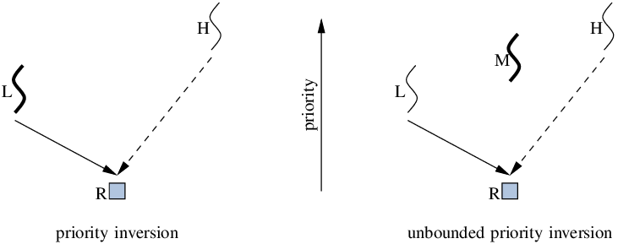
Deadlock and Starvation
priority inversion example:
Assume three processes
L, M, and H with the priority order: L < M < H.
Assume that
process H requires resource R, which is currently hold by process L.
process H would wait for L to finish using resource R.
However, process M becomes runnable, and preempts process L.
Consequence:
process M (with middle priority) has affected how long process H must wait for L to relinquish resource R.

Slide 54
Deadlock and Starvation
Solution
Use priority-inheritance protocol
All processes that are accessing resources needed by a higher-priority process inherit the higher priority until they are finished with the resources in question.
When they are finished, their priorities revert to their original values.
This protocol solve the previous priority inversion problem

Slide 55
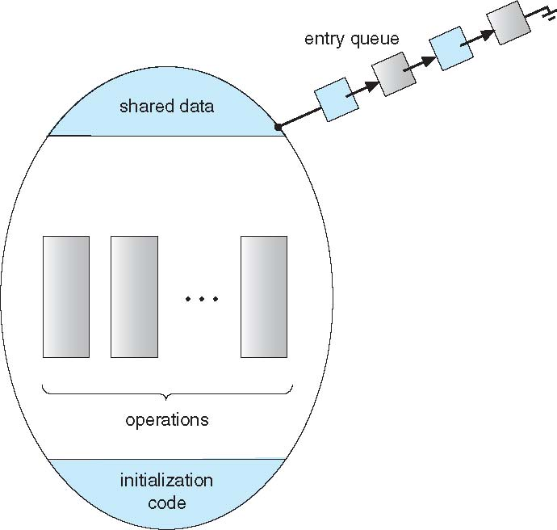
Monitors
Monitor (管程)
A high-level abstraction that provides a convenient and effective mechanism for process synchronization
Abstract data type, internal variables only accessible via procedures
Only one process may be active within the monitor at a time
Can utilize condition variables to suspend or resume processes
monitor monitor-name
{
// shared variable declarations
procedure P1 (…) { …. }
procedure Pn (…) {……}
Initialization code (…) { … }
}

Slide 56
Chapter 9: Main Memory

Slide 57
Outline
Background
Memory Allocation
Contiguous Memory Allocation
Frame
Page Table
Address Translation
Page Table Schema
Hierarchical Page Table
Hash Table
Inverted Table
Examples

Slide 58
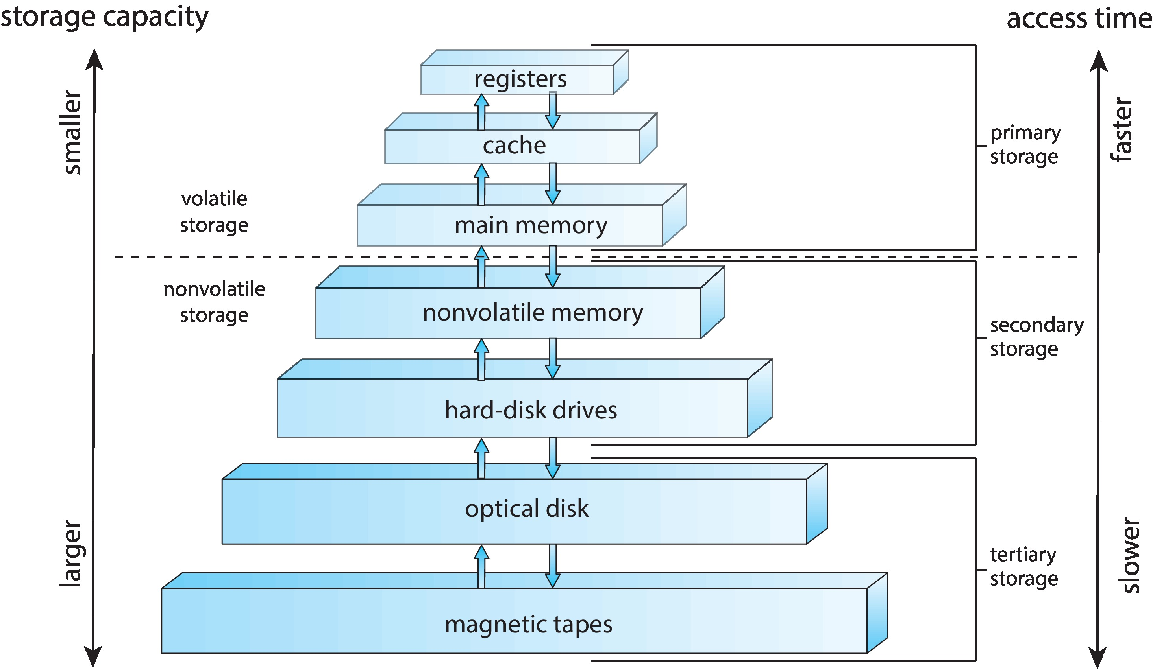
Review: Storage Hierarchy
Process
Program
Then, how CPU accesses the process in the memory?

Slide 59
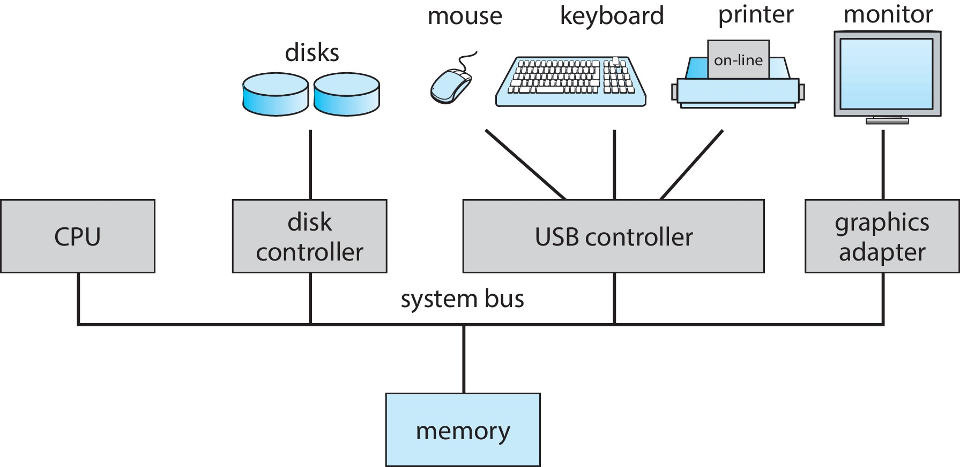
Relationship of CPU and Memory
Main memory and registers are only storage that CPU can access directly
Register access is done in one CPU clock (or less)
Main memory can take many cycles, causing a stall (delay)
Memory unit only sees from CPU a stream of:
addresses + read requests, or
address + data and write requests
A PC System Structure
Register file
(寄存器堆)
ALU
Arithmetic logic unit
Cache
memories
Main
memory
Bus interface
System bus
I/O
bridge
Memory bus
CPU chip
Inside CPU

Slide 60
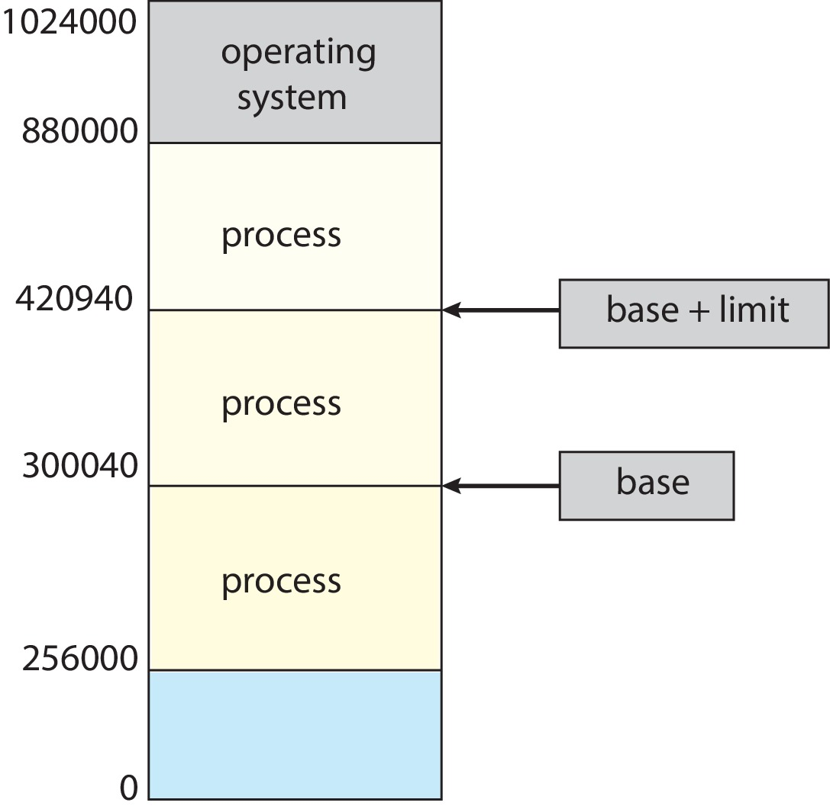
Protection
CPU notifies memory where to read or write
Is this “where” reliable?
Will the instructions go to other process’s land?
Protection is needed
An old but simple method
a pair of base register and limit register for each process to address of the process

Slide 61
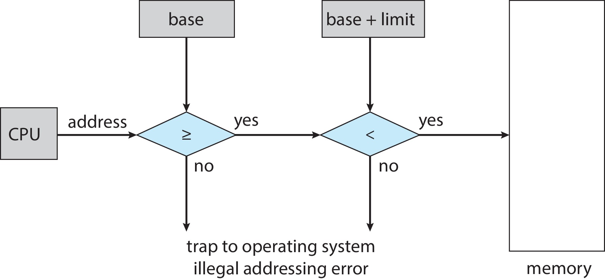
Hardware Address Protection
Two registers are needed
Base register
Limit register
CPU must check every memory access generated in user mode to be sure it is between base and limit for that user
The instructions to load base and limit registers are privileged
No process can spy on another one by changing its own base register to be the same as other’s.

Slide 62
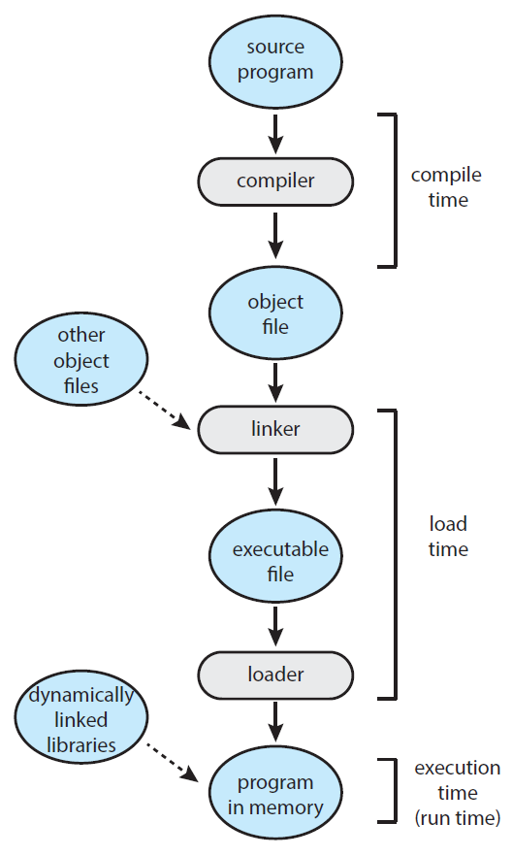
Address Binding in A Typical Multistep Processing of a User Program
How are process addresses determined in memory?
Addresses are represented in different ways at different stages of a program’s life
Source code addresses usually symbolic
i.e. int count; &count
Compiled code addresses bind to relocatable addresses (addresses relative to the start of the code).
i.e. “14 bytes from beginning of this code module”
Linker or loader will bind relocatable addresses to absolute addresses (addresses relative to the lowest address 0000 in memory).
i.e. 74014
Each binding maps one address space to another address space

Slide 63
Linking: Dynamic vs Static
Static linking –system libraries and program code are combined by the loader into the binary image
Every program includes library: wastes memory
Dynamic linking –linking is postponed until execution/run time
Operating system checks if routine (子程序) is in process memory address, If not in address space, add to address space
Small piece of code, stub (存根), is used to locate the appropriate memory -resident library routine
Stub replaces itself with the address of the routine and executes the routine
Particularly useful for libraries which are used by many processes
Keep only one copy of the library in memory which is shared by all the processes.
known as shared libraries (.dll on Windows and .so on Linux, and .a is Linux static library)

Slide 64
Binding of Instructions and Data to Memory
Types of systems determine when the binding to memory address happens
Compile time: Absolute address is used in code
Example: embedded systems with no kernel.
Disadvantage: code must be re-compiled if starting location in memory changes
Load time: Relocatable code is generated if memory location is not known at compile time
Example: very old multiprogramming systems
Program’s code has a relocation table of relative addresses of all the things in the code
The real memory address is calculated according to the given location.
Disadvantage: the address in memory is fixed after the program is loaded into memory.

Slide 65
Binding of Instructions and Data to Memory
Types of systems determine when the binding to memory address happens
Execution time: Binding is delayed until run time.
Example： most computers today
A process can be moved during its execution from one memory segment to another
Need hardware support for address maps
e.g., MMU
This lecture talks about the binding in execution time.

Slide 66
Logical vs. Physical Address Space
Memory management is to
bind a logical address space to a separate physical address space
Logical address
generated by the Program/CPU
also referred to as virtual address
all the addresses used by the CPU
Addressed in bytes
Size of space depends on the CPU bits
Physical address
all the addresses used by the memory hardware
Addressed in bytes
Size of space depends on real size of physical memory
Thinking:
If a computer has 32-bit CPU and memory address is 16-bit, how big is the logical address space and the physical memory address?

Slide 67
Logical vs. Physical Address Space
Logical and physical addresses are the same in
compile-time address binding, and
load-time address-binding schemes
logical (virtual) and physical addresses differ in
execution-time address-binding scheme facilitates swapping
This lecture talks about the binding of logical and physical addresses at execution time.

Slide 68
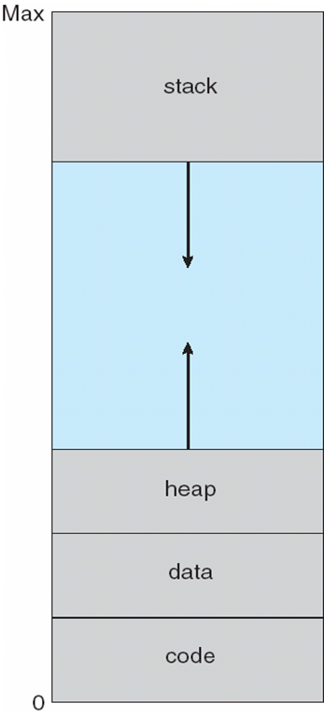
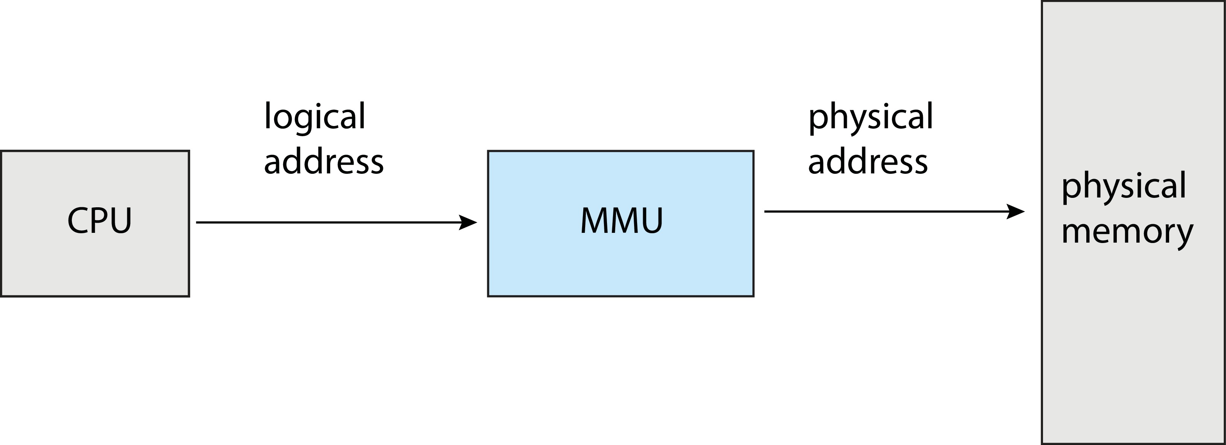
Memory-Management Unit (MMU)
MMU
Memory Management Unit
Hardware device that at run time maps (translates) logical (virtual) address to physical address
Logical address space

Slide 69

Memory-Management Unit (Cont.)
A simple mapping scheme
relocation register
limit register
Logical addresses of all processes start at 0000
Two processes can use the same logical addresses, these addresses will be mapped to different places in the physical memory
The kernel changes the relocation and limit register during a context switch
e.g.,
14000
e.g.,
346
e.g.,
14346
Logical address space

Slide 70
Dynamic Loading
Should the entire program be loaded in to the memory to start the execution?
No!
Code is loaded from the hard disk into memory only when it is needed, on demand
Dynamic loading
The loading of a process routine when it is called rather than when the process is started.
Why
Better memory-space utilization
Unused routine is never loaded
Some large amounts of code handle infrequently occurring cases
How
All routines are kept on disk in relocatable load format
Implemented through program design by programmers, not OS
OS can help by providing libraries to implement dynamic loading

Slide 71
Memory Allocation
Memory can be shared by many processes, including kernel and user processes
It should be allocated efficiently
Resident kernel usually is held in low memory
User processes is held in high memory
Memory for each process can be
Contiguous (early method)
Not contiguous (modern method)
P1
P2
P1-1
P2-2
P1-2
P2-1

Slide 72
Continuous Partition
Memory is divided into multiple partitions
Size of each partition is fixed
Multiple-partition allocation
Disadvantages:
Degree of multiprogramming is limited by number of partitions
Memory is wasted if a process does not fully use its partition
Size of each partition is variable
Variable-partition
Propositional to a given process’ size

Slide 73
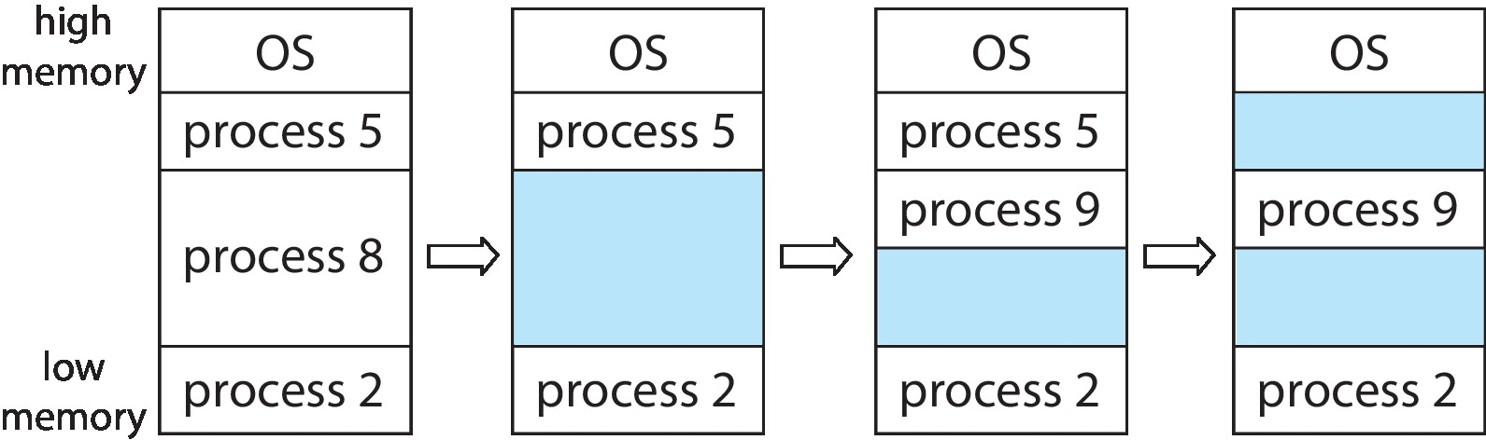
Continuous Partition: Variable Partition
Kernel maintains information about
allocated partitions
free partitions (hole)
Hole
block of available memory
holes of various size are scattered throughout memory
When a process arrives, it is allocated memory from a hole large enough to accommodate it
When a process exits, its partition is freed, adjacent free partitions are combined (coalesced/merged)
Thinking:
Memory after process 9 is released?

Slide 74
Continuous Partition: Variable Partition
How to satisfy a request of size n from a list of free holes?
Three allocation algorithms
First-fit: Allocate the first hole that is big enough
Best-fit: Allocate the smallest hole that is big enough;
Worst-fit: Allocate the largest hole
Comparison of three algorithms
Speed
First-fit > best-fit and worst-fit
Both best-fit and worst-fit need to search the whole list
Memory usage
Best-fit > first-fit > worst-fit (theoretically)
First-fit > best-fit (case studies)
Reason: best-fit produces many small holes that can never be used

Slide 75
Fragmentation
External Fragmentation
Total memory space exists to satisfy a request, but it is not contiguous
Small holes might be wasted because the holes are too small to fit any process.
Internal Fragmentation
Allocated memory may be slightly larger than requested memory; this size difference is memory internal to a partition, but not being used.
Any memory which is allocated to a process but that the process did not ask for is wasted.
P1
20K
P2
20K
P1
40K
P2
P3: 31K
20+20>31,
but not contiguous
P3: 31K
2⁵K=32K will be allocated,
but 1k is not used
External fragmentation
Internal fragmentation

Slide 76
Fragmentation
First fit analysis reveals that given N blocks allocated, 0.5 N blocks lost to fragmentation
50-percent rule
the memory lost to fragmentation is about 50% the size of the allocated memory
1/3 of RAM may be unusable

Slide 77
Fragmentation
Solutions to fragmentation problems
External fragmentation
Compaction
Shuffle memory contents to place all free memory together in one large block
possible only if relocation is dynamic, and is done at execution time
Pay attention to I/O problem while there is I/O operations on the affected memory
Use non-contiguous memory allocation
Internal fragmentation
No way
Memory is allocated in the block of 2^{n} bytes, rather than byte by byte.

Slide 78
Non-continuous Partition
Physical address space of a process can be noncontiguous
Process is allocated physical memory whenever the total free memory blocks are enough
Avoids external fragmentation
Frame
Divide physical memory into fixed-sized blocks
Each block is called a frame
The size of each frame is power of 2, between 512 bytes and 16 Mbytes
Kernel keeps track of all free frames
Thinking:
If RAM’s address uses 16 bits, each frame is 4K, how many frames are in the memory?

Slide 79
Non-continuous Partition
0000
Frame 0
Frame 1
Frame 2
Frame 15
0000 0000 0000
16 bits: 2¹⁶ , 4K: 4*2¹⁰ = 2¹²
Total frames: 2¹⁶/ 2¹²= 2⁴
1111 1111 1111
0001
0000 0000 0000
1111 1111 1111
0010
0000 0000 0000
1111 1111 1111
4
12
Frame number
Offset in each frame
Thinking:
If RAM’s address uses 16 bits, each frame is 4K, how many frames are in the memory?
1111
0000 0000 0000
1111 1111 1111

Slide 80
Non-continuous Partition
0000
Frame 0
Frame 1
Frame 2
Frame 15
0000 0000 0000 0000
16 bits: 2¹⁶ , 4K: 4*2¹⁰ = 2¹²
Total frames: 2¹⁶/ 2¹²= 2⁴
0000 1111 1111 1111
0001
0001 0000 0000 0000
0001 1111 1111 1111
0010
0010 0000 0000 0000
0010 1111 1111 1111
4
12
Frame number
Offset in each frame
Thinking 1:
If a datum is in the address
0100 0000 0000 0001?
Which frame is it in? where is it in the frame?
Thinking 2:
If a process’s size is 8K + 1， how many frames are allocated? Is there internal fragmentation?
1111
1111 0000 0000 0000
1111 1111 1111 1111

Slide 81
Non-continuous Partition
How a logical address maps to a physical address?
Pages
Divide logical memory into blocks of same size called pages
Page size = frame size
To run a program of size N pages, need to find N free frames and load program
Frames can be anywhere(non-contiguous) in RAM!
A page table is needed to translate logical to physical addresses
Thinking:
If logical space uses 32 bits, each frame is 4K, how many pages are there in logical space? 2³²/ 2¹²= 2²⁰

Slide 82

Address Translation Scheme: Page Table
The data in physical memory is not in the same order as in the logical address space of the process because a page can be stored in any frame in RAM!
Each process has a page table
Process access the memory indicated by its page table.
Page table is
part of the process’s PCB.
invisible to the process itself.

Slide 83
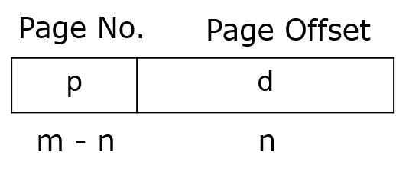
Address Translation Scheme: Page Table
Given a logical address space 2^{m} and page (frame) size 2^{n}, there are 2^{m}/2^{n} = 2^{m-n} pages in a process’s logical address space
Logical address generated by CPU (m bits) is divided into
Page number (p) – used as an index into a page table which contains base address (frame number) of each page in physical memory
Page offset (d) – combined with base address (frame number) to define the physical memory address that is sent to the memory unit

Slide 84
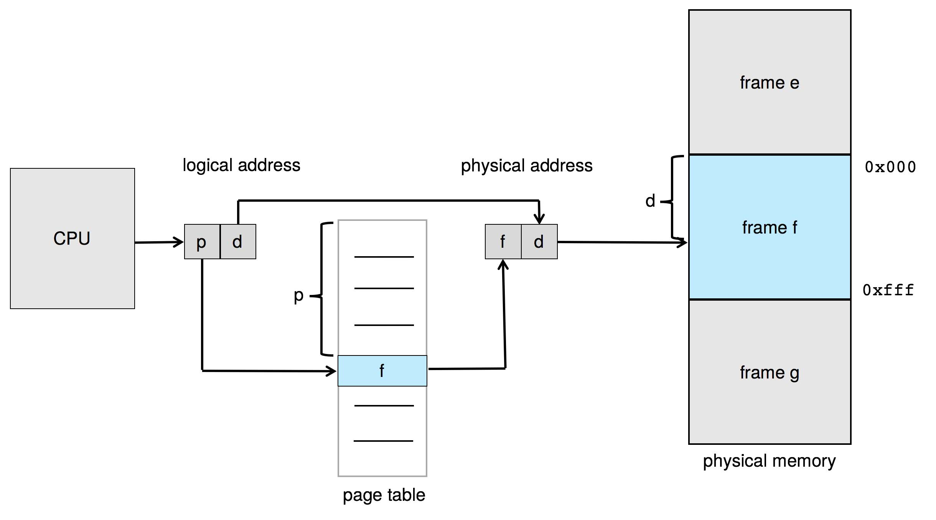
Paging Hardware
Page number p to frame number f translation

Slide 85
TLB
TLB table
Given a logical page number p
If p is in TLB (called TLB hit)
get corresponding frame number from it
If p is not in the TLB table (called TLB miss)
get frame number from page table in memory
then update the TLB to contain this page # and frame #
Reason
if that page was just used by the process, it is probably going to be used again soon.

Slide 86
TLB
TLB is
typically small
64 to 1,024 entries
Shared by multiple processes
Store address-space identifiers (ASIDs) in each TLB entry to uniquely identify each process to provide address-space protection for each process
Reduce the fresh time at every context switch between processes
How is a TLB entry replaced by a new page-frame pair?
Replacement policies must be considered
Some entries can be wired down (never be replaced) for permanent fast access (for key kernel code)

Slide 87

Paging Hardware With TLB
TLB: can be shared by multiple processes, in that case, identifier for each process should be added.
In MMU
On TLB miss: add <p, f> to TLB for next time.
Page table: own by each process

Slide 88
Effective Access Time: An Example
Hit ratio α is
percentage of times that a page number is found in the TLB
Effective memory access time
EAT = α x （c+m）+（1- α） x （c+2m）
c: TLB access time, m: memory access time
An example
α: 80%, c: 10 nanoseconds, m: 90 nanoseconds
EAT = 0.80 x （10+90） + 0.20 x （10+90 x2） = 118 ns
18% slowdown in access time
If α: 99%
EAT = 0.99 x （10+90） + 0.01 x （10+90 x2） = 100.9ns
only 0.9% slowdown in access time
Big table solutions
Hierarchical paging, Hashed page tables, Inverted page tables

Slide 89

Hierarchical Page Tables
Split one (big) page table into multiple (small) page tables
two-level page table
Outer page table
Each entry indicates the position of small page table
Inner (small) page tables
Each small page table (also called page of page table) has the page size
Different small page tables can be put in different places
Only the part of the page table that the process requires right now needs to be in memory!

Slide 90
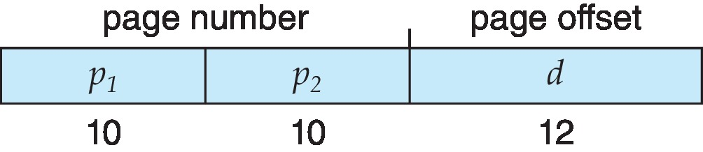

Two-Level Paging Example
logical address space: 32-bit (m=32), page size: 4 KB (n=12)
Originally
page table length: 2^{m-n} = 2²⁰
Two levels
p₁ : a 10-bit page number (1KB)
an index into the outer page table
p₂ : a 10-bit page offset (1KB)
the displacement within the page of the inner page table
20
12
physical address
f | d
f
Advantage: save memory
only part of the page table needs to be in memory
Disadvantage：three memory access
Address translation process

Slide 91
Hashed Page Tables
index
Page p and q are hashed to the same location in the table
An entry in the hash table contains a chain of elements hashing to the same location.
Each element contains
the virtual page number (e.g., q)
the value of the mapped page frame (e.g., s)
a pointer to the next element.
This method is commonly used for the address with more than 32 bits

Slide 92

Inverted Page Table
pid: process id
p: page number
d: offset in that page
The length of page table is the same as the size of physical memory
All processes share one page table
The page table is actually a reflection of layout of the physical memory frames

Slide 93
Chapter 10: Virtual Memory

Slide 94
Outline
Background
Demand Paging
Copy-on-Write
Page Replacement
Allocation of Frames
Thrashing
Allocating Kernel Memory
Other Considerations
Example

Slide 95
Objectives
To describe the benefits of a virtual memory system
To explain the concepts of demand paging, page-replacement algorithms, and allocation of page frames
To discuss the principle of the working-set model
To explore how kernel memory is managed

Slide 96

Multiprogramming
Multiprogramming
Multiple processes can reside in the memory at the same time
Problem: if a program needs to be run, but there is no enough free memory
One solution： swap out (换出) a process and swap in (换入) the target process
Backing store （后备存储器）
is fast hard disk large enough to accommodate copies of all process memory images for all users
has direct access to memory images

Slide 97
Swapping
A complete process can be swapped temporarily out of memory to a backing store, and then brought back into memory for continued execution
A swapper manipulates entire process swapping
Advantage
Increase multiprogramming
Disadvantage
Context switch time can then be very high
Total context switch time includes swapping time for the whole process
Can the swapping time be reduced by reducing the size of memory swapped?

Slide 98
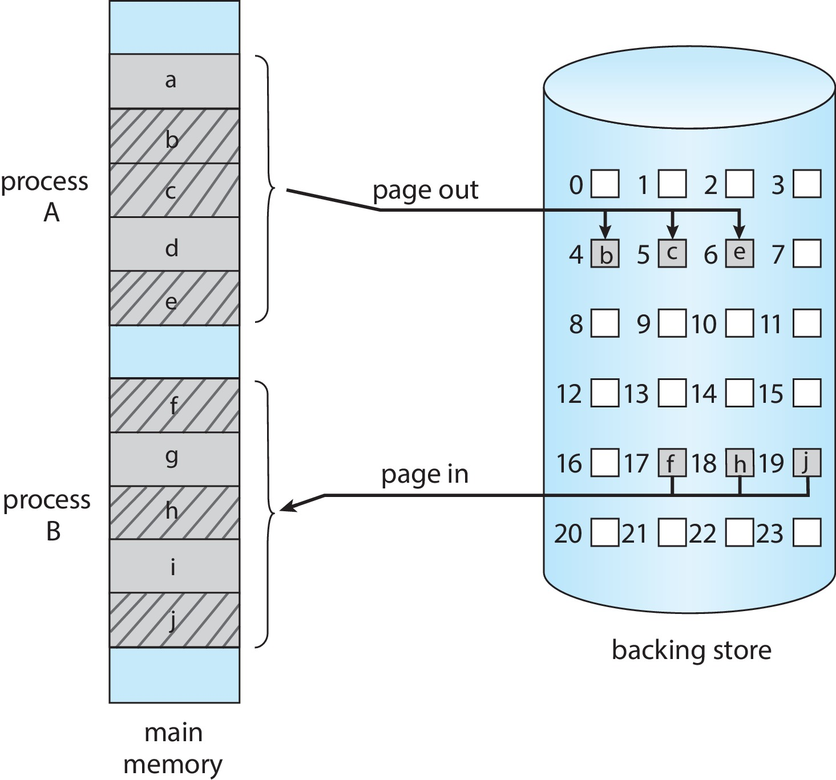
Swapping with Paging
When memory is low, unused pages are swapped to disk (instead of whole processes)
How to determine which pages are unused?
What happens when a process suddenly tries to access a page that was swapped out?

Slide 99
Background
Program can be partially loaded into memory
Error handling code, unusual routines, large data structures may not be needed for most of time
Program length is no longer constrained by limits of physical memory
Each program takes less memory → more programs run at the same time
Less I/O needed to load programs into memory → each user program runs faster
Virtual memory – separation of user logical memory from physical memory
Logical address space can therefore be much larger than physical address space
Only needed pages are loaded into memory

Slide 100
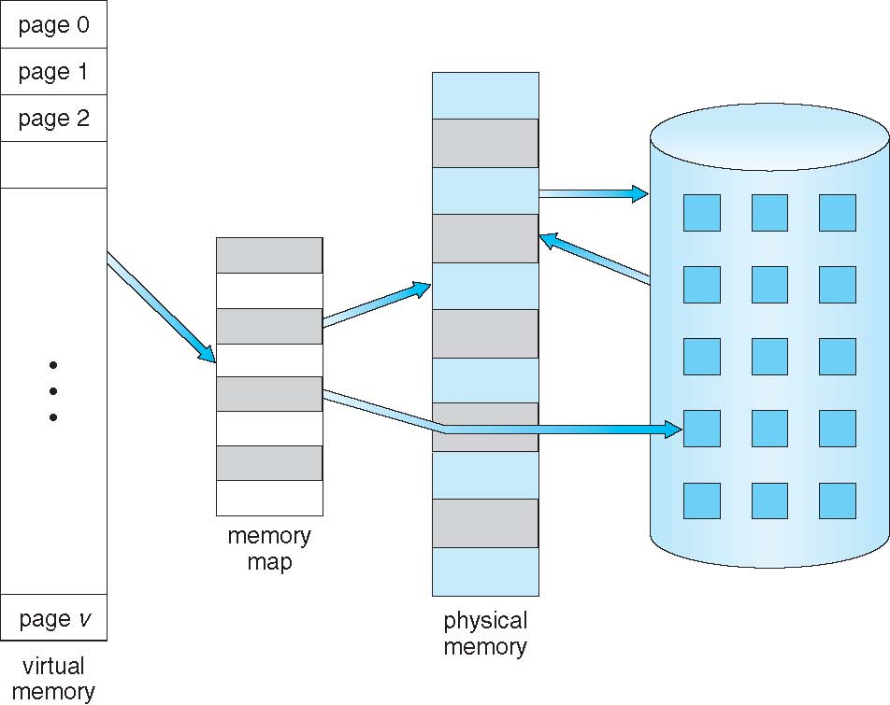
Virtual Memory That is Larger Than Physical Memory
Virtual memory for a process
Backing store
On a modern computer,
the logical address space (virtual memory) is 2⁶⁴ bytes = 16 billion GB, but
the physical address space (RAM) is only a few GB (a few hundred GB for the biggest computers on earth).

Slide 101
Demand Paging
Demand paging
Could bring a page into memory only when it is needed
Advantages:
Less I/O needed, no unnecessary I/O
Less memory needed
Faster response
More users/processes
Page is needed ( called a reference to the page
invalid reference might be caused by
wrong address ⇒ process abort
not-in-memory ⇒ bring to memory
A pager can swap in and out one page at a time (not a whole process like swapper does).

Slide 102
Demand Paging: Basic Concepts
The pager brings in only those pages into memory that the process actually wants to use
Question: How to determine that set of pages?
Hardware support: MMU
If pages needed are already memory resident
No difference from non-demand paging
If pages needed are not in memory
Need to detect and load the pages into memory from storage

Slide 103
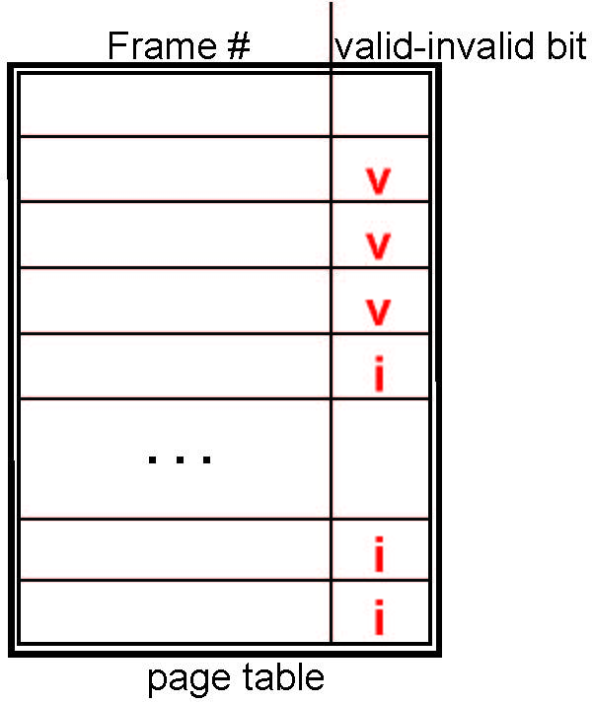
Valid-Invalid Bit
To check if a reference is valid or not, associate each page table entry with a valid–invalid bit
v: the page is in-memory
i : the page is
either not-in-memory, or
a wrong logical address
Initially valid–invalid bit is set to i on all entries

Slide 104
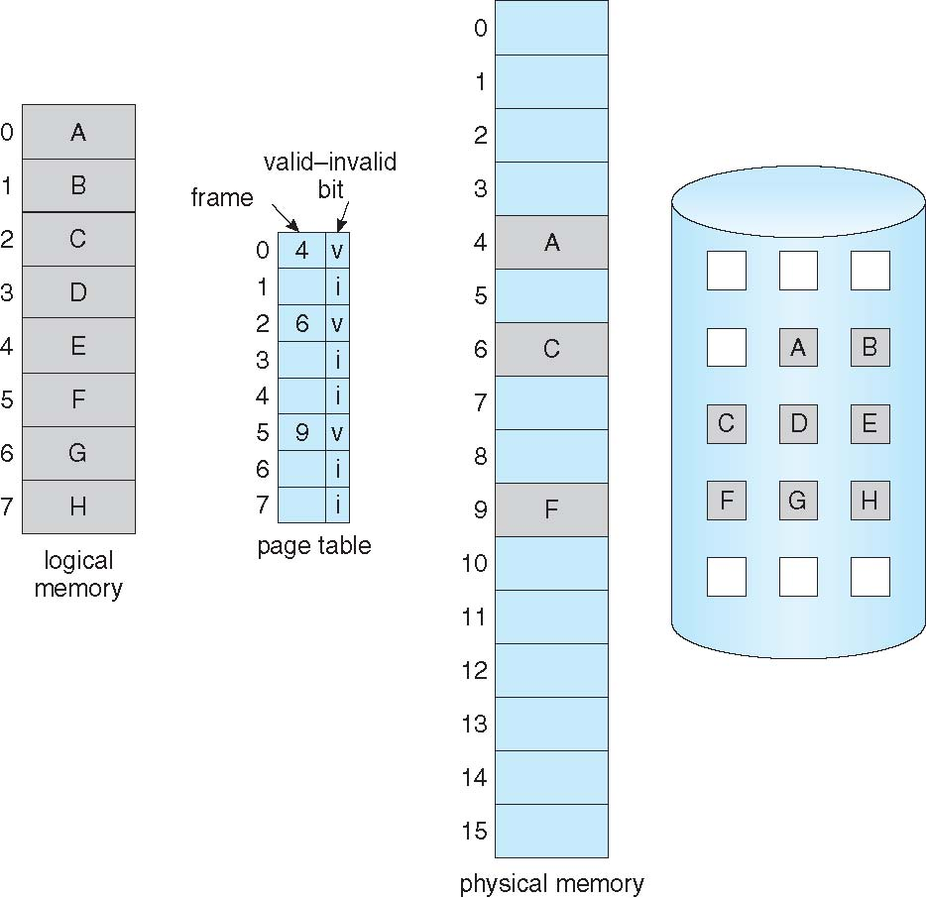
An Example: Some Pages Are Not in Main Memory
Backing store
Pages 0, 2, and 5 are in the memory
Pages 1, 3, 4, 6, and 7 are not in the memory

Slide 105
Page Fault
Page fault
Caused when a process makes a reference to a page which is not in RAM,
MMU detects that the page is marked as invalid in the process’s page table,
Two possibilities
the process is trying to access a page that does not exist at all
E.g., the process has pages for 1 to 10, but CPU wants to access page 12
Solution: Process aborts
The page is not in memory but is somewhere on the hard disk
E.g., the process has pages from 1 to 10, CPU wants to access page 2, but this page has not been loaded into RAM
Solution: Load the page from hard disk to RAM

Slide 106

Steps in Handling a Page Fault
CPU makes a reference to a page which is marked i in the page table
MMU traps to kernel
if the reference page does not exist at all, stop the process;
otherwise, go to 3
Find the page in the hard backing store
Find a free frame in the memory and load the page into that frame
Reset the page table such that the valid bit is v
Restart the process by re-executing the instruction which caused the page fault.

Slide 107
Aspects of Demand Paging
Pure demand paging
Start process with no pages in memory (extreme case)
Immediate page fault for the first instruction in the process
A given instruction could access multiple pages -> multiple page faults
E.g., suppose the following code
int d; //global variable
int main(){
int i; //local variable
int *p; // pointer
p = (int*) malloc(sizeof(int))
… …
//Thinking： how many pages are usually //accessed for the following instruction *p= i + d;
}

Slide 108
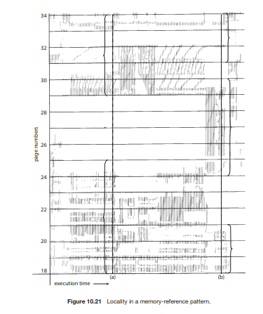
Locality Reference
Locality of reference
The tendency of processes to reference memory in patterns rather than randomly
Results in reasonable performance from demand paging
It will fault for the pages in its locality until all these pages are in memory
It will not fault again until it changes localities
Process migrates from one locality to another over time
Localities may overlap (over time)
Locality in a memory-reference pattern

Slide 109
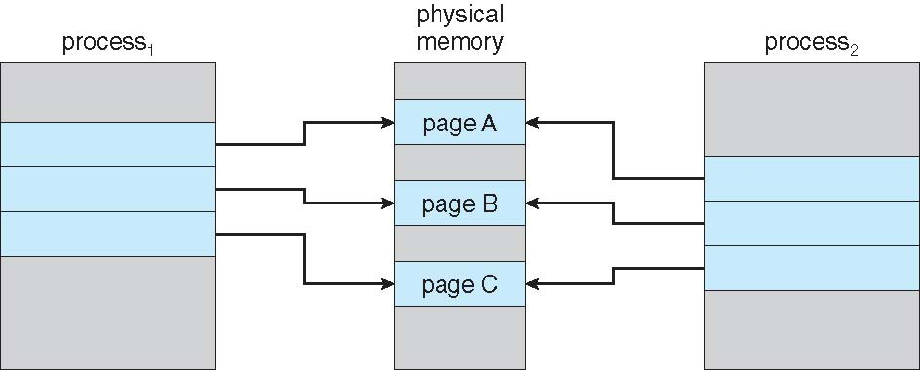
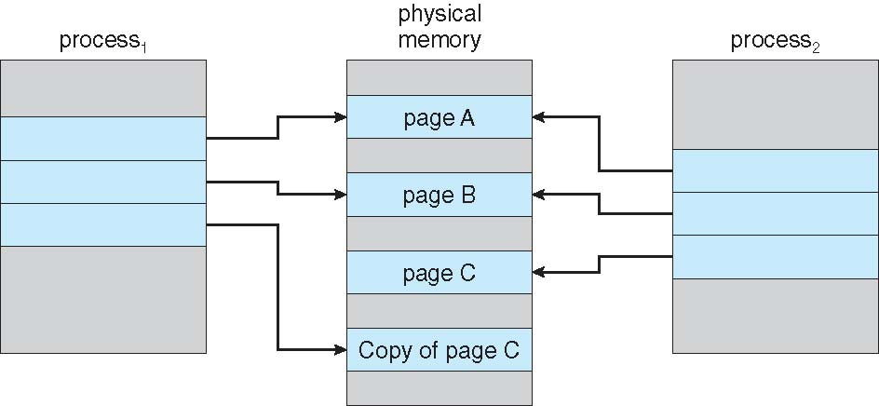
Copy-on-Write
Copy-on-Write (COW) allows both parent and child processes to initially share the same pages in memory (vfork instead of fork)
When a child process is initially created,
only copy the page table of its parent
share parents’ pages
the shared pages are write-protected (using protection bits of page tables).
If either process modifies a shared page, then copy that page
f1
0
1
2
f1
f2
0
1
2
f2
f3
f3
f4
Page table
parent
0
1
2
f1 (A)
f2 (B)
f3 (C)
0
1
2
f1 (A)
f2 (B)
f3 (C)
Page table
child
Page table
parent
Page table
child
0
1
2
f1 (A)
f2 (B)
f4 (Copy C)
0
1
2
f1 (A)
f2 (B)
f3 (C)

Slide 110
What Happens if There is no Free Frame?
When there is a page fault, a new page should be loaded in
Find a free frame for this new page to load in
Question: Memory has used up, i.e., no frame is available for a new page
Solution: swap pages out from memory
Page replacement
Find some page in memory, but not really in use, page it out
Algorithm consideration
How to know which frames are free?
If no frame is free, which frames should be freed (i.e., which pages should be replaced，a victim)
expectation: minimum number of page faults
Same pages may be brought into memory several times

Slide 111
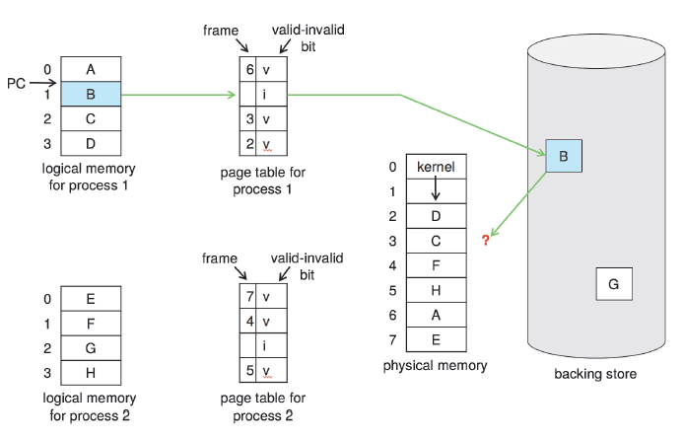
Need For Page Replacement
Reference to page 1
page 1 is not in memory
Memory is full
Two questions:
1. Replace page from p1 or p2?
2. Which page to replace?

Slide 112
Global vs. Local Allocation
Question 1: from which process a page is replaced?
Global allocation
Process selects a replacement frame from the set of all frames
One process can take a frame from another process.
The # of frames allocated to each process will change.
Local allocation
Each process selects from only its own set of allocated frames.
The # of frames allocated to each process does not change.

Slide 113
Global vs. Local Allocation
Which is better: Global or Local
Global replacement
Process execution time can vary greatly
But greater throughput, so more commonly used
Local replacement
More consistent per-process performance
But possibly under-utilized memory

Slide 114
Page Replacement
Question 2: Which pages to replace (be removed from RAM)?
Two kinds of pages are good candidates
pages which are not used by a process right now
If a page has not been used for a while, maybe it will not be used in near future
Pages that are not modified (called dirty) recently
These kinds of pages do not need to be paged out
An algorithm is needed to find the right frame to free
which pages have not been used recently?
which pages have not been modified recently?
“recent”: how to decide the period for “recent”?
Victim page
The page which will be replaced

Slide 115
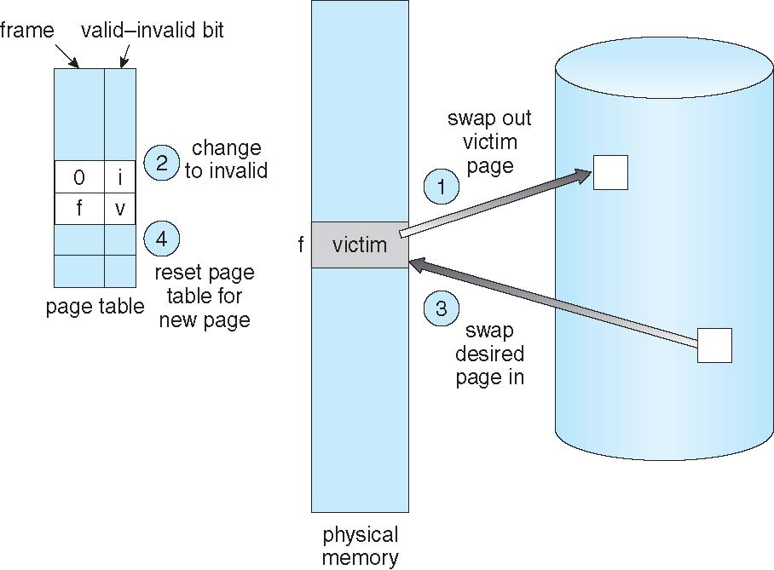
Page Replacement
If dirty
A reference to this page
f | v
0 | i
victim
Before
replacement

Slide 116
Page and Frame Replacement Algorithms
Frame-allocation algorithm determines
How many frames to give each process
Page-replacement algorithm
Which frames to replace
Want lowest page-fault rate on both first access and re-access
Algorithm evaluation
Run it on a particular string of memory references (reference string) and compute the number of page faults on that string
String is just page numbers, not full addresses
Results depend on number of frames available

Slide 117
Page Replacement Algorithms
Algorithms
FIFO
Optimal
Least Recently Used (LRU)
Second chance
Enhanced second chance
Reference string used in the examples
7,0,1,2,0,3,0,4,2,3,0,3,2,1,2,0,1,7,0,1
Each number is the page number to reference

Slide 118
FIFO
Rule
Replace the oldest one
Implementation
OS maintains a circular queue of all pages
Page at head of the list: Oldest one
Page at the tail: Recent arrival
When there is a page fault
Page at the head is removed
New page added to the tail

Slide 119
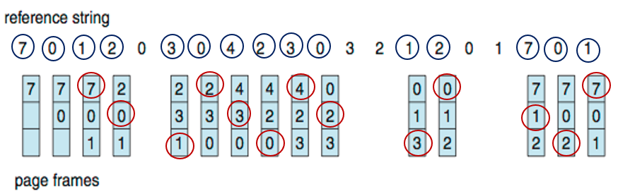
First-In-First-Out (FIFO) Algorithm
Reference string: 7,0,1,2,0,3,0,4,2,3,0,3,2,1,2,0,1,7,0,1
3 frames (i.e., 3 pages can be in memory at a time)
Total page faults: 15
Thinking:
Can adding more frames reduce the number of page faults?

Slide 120
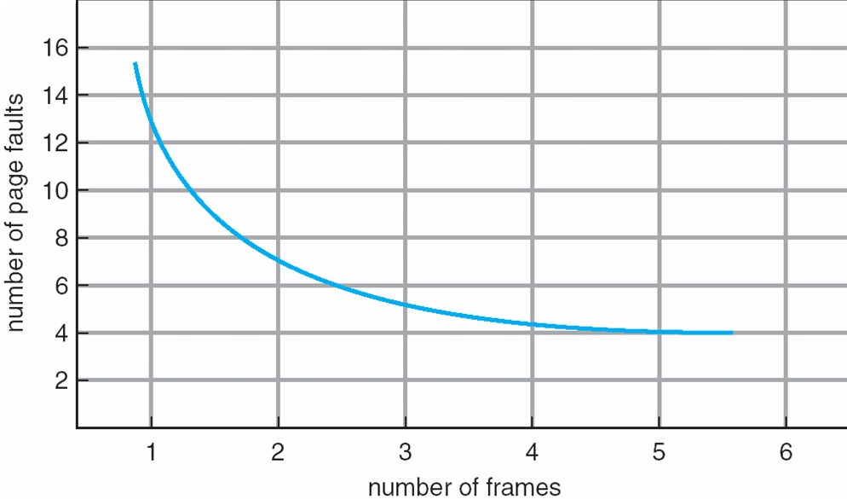
Graph of Page Faults Versus The Number of Frames
Intuition but not Reality

Slide 121
FIFO Illustrating Belady’s Anomaly
Consider 1,2,3,4,1,2,5,1,2,3,4,5
Adding more frames might cause more page faults!
1 |  | 2 |  | 3 |  | 4 |  | 1 |  | 2 |  | 5 |  | 1 |  | 2 |  | 3 |  | 4 |  | 5 |  | page fault
1 |  | 1 |  | 1 |  | 4 |  | 4 |  | 4 |  | 5 |  | 5 |  | 5 |  | 5 |  | 5 |  | 5
 |  | 2 |  | 2 |  | 2 |  | 1 |  | 1 |  | 1 |  | 1 |  | 1 |  | 3 |  | 3 |  | 3 |  | 9
 |  |  |  | 3 |  | 3 |  | 3 |  | 2 |  | 2 |  | 2 |  | 2 |  | 2 |  | 4 |  | 4
1 |  | 1 |  | 1 |  | 1 |  | 1 |  | 1 |  | 5 |  | 5 |  | 5 |  | 5 |  | 4 |  | 4
 |  | 2 |  | 2 |  | 2 |  | 2 |  | 2 |  | 2 |  | 1 |  | 1 |  | 1 |  | 1 |  | 5 |  | 10
 |  |  |  | 3 |  | 3 |  | 3 |  | 3 |  | 3 |  | 3 |  | 2 |  | 2 |  | 2 |  | 2
 |  |  |  |  |  | 4 |  | 4 |  | 4 |  | 4 |  | 4 |  | 4 |  | 3 |  | 3 |  | 3
3 frames
4 frames
Belady’s Anomaly
For some page-replacement algorithms, the page-fault rate may increase as the number of allocated frames increases.

Slide 122
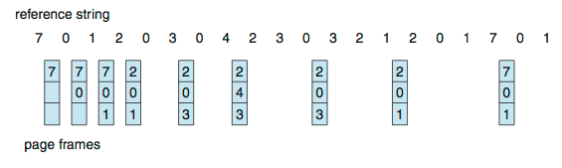
Optimal Algorithm
Replace the page that will not be used for longest period of time
Problem
Can’t read the future
This method can only be used to measure how other algorithms are close to the optimal
Total page faults: 9

Slide 123
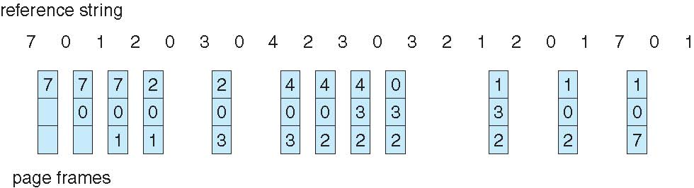
Least Recently Used (LRU) Algorithm
Replace page that has not been used in the most amount of time
Better than FIFO(15) but worse than OPT(9)
LRU is a good algorithm and frequently used
LRU and OPT don’t have Belady’s Anomaly
Total page faults: 12

Slide 124
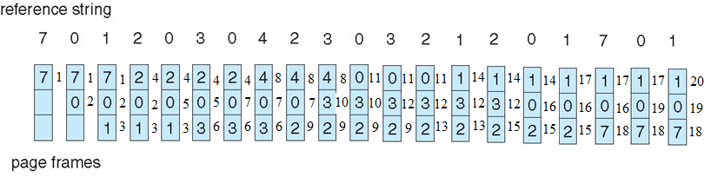
LRU Algorithm Implementation 1: Counter
Counter implementation
There is a global counter that increases by 1 whenever a page is referenced. Every page in the memory has its own counter
When a page is referenced, its counter is synchronized with the global counter
When a page needs to be replaced, find the page in the memory with the smallest value
Thinking:
What is the disadvantage of this algorithm (time issue)?

Slide 125
LRU Approximation Algorithms
LRU approximation algorithm 2
Second-chance algorithm
Use a circular FIFO and reference bit for each page in memory
If page to be replaced has
reference bit = 0
replace it
reference bit = 1
set reference bit to 0
search for the next page

Slide 126
Allocation of Frames
Two major allocation schemes
Fixed allocation
Equal allocation
Each process is allocated same number of frames
Disadvantage
Space waste for small process
Propositional allocation
Allocate frames according to the size of a process
Disadvantage
Process size might be changed during the execution
Priority allocation
the ratio of frames depends on the combination of size and priority of a process
Replace the pages of process with lower priority

Slide 127
Thrashing(系统颠簸)
If a process does not have “enough” frames in memory, the page-fault rate is very high
Replace page frequently
The replaced page might be used again
This leads to:
Low CPU utilization
Operating system keeps adding new process, trying to increase CPU utilization
Things get worse -> entering a bad cycle
Thrashing
A process is busy swapping pages in and out, instead of doing useful work.

Slide 128
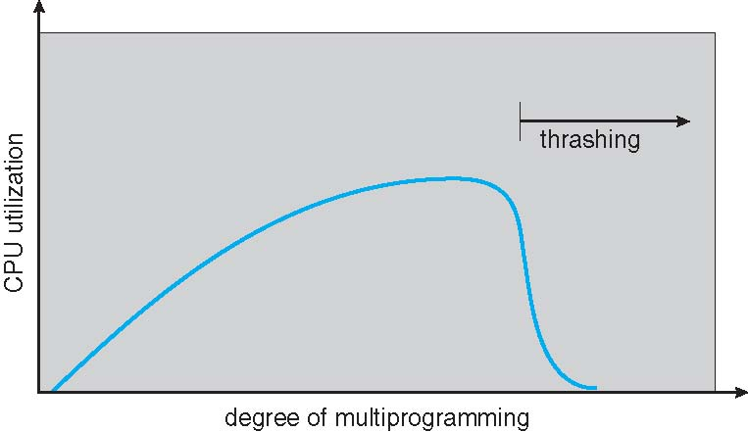
Thrashing (Cont.)
CPU utilization also increases
CPU utilization drops
Solutions to thrashing
Decrease the degree of multiprogramming
Establish “acceptable” page-fault frequency (PFF) rate and use local replacement policy
Install enough physical memory (hardware)
Install faster hard disk

Slide 129
Page-Fault Frequency
If actual rate too low, process loses frame (we think too many frames assigned, remove some frames)
If actual rate too high, process gains frame

Slide 130
Chapter 13:
File-System Interface
Operating System Concepts – 10th Edition
Silberschatz, Galvin and Gagne ©2018

Slide 131
Outline
File Concept
Access Methods
Disk and Directory Structure
File-System Mounting
File Sharing
Protection

Slide 132
Objectives
To explain the function of file systems
To describe the interfaces to file systems
To discuss file-system design tradeoffs, including access
methods, file sharing, file locking, and directory structures
To explore file-system protection

Slide 133
File Concept
A file is
a named collection of related information that is recorded on
secondary storage (e.g. Disk, SSD, Flash, etc.)
a sequence of bits, bytes, lines, or records, the meaning of which is defined by the file’s creator
Smallest logical storage unit for user view
A file
uses contiguous logical address space
represents programs or data
File system resides on secondary storage (disks)
Provides user interface to storage, mapping logical to physical
Provides efficient and convenient access to disk by allowing data to be stored, located, retrieved easily

Slide 134
File Attributes
A file usually has following basic attributes
Name – only information kept in human-readable form
Identifier – unique tag (number) identifies file within file system
Type – needed for systems that support different types
Location – pointer to file location on device
Size – current file size
Protection – controls who can do reading, writing, executing
Time, date, and user identification – data for protection,
security, and usage monitoring
Information about files （metadata） are kept in the directory structure, which is maintained on the disk

Slide 135
File Operations
File is an abstract data type.
Six basic file operations
Create a file
Write a file
Read a file
Reposition within a file
Truncate a file
File is reset to length zero
File space is released
File attributes are unchanged
Delete a file
Except file creation and deletion, all other operations need to
open the file first and then close the file after the operation

Slide 136
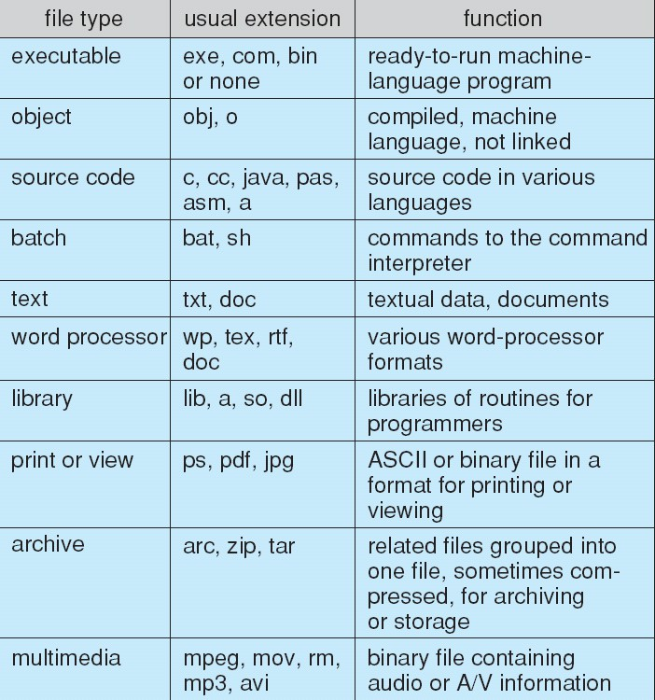
File Types – Name, Extension
The OS uses the extension to indicate the type of the file
Most common types
.c
.exe
.docx
.pdf
.jpg
.png
.zip
Common file types

Slide 137
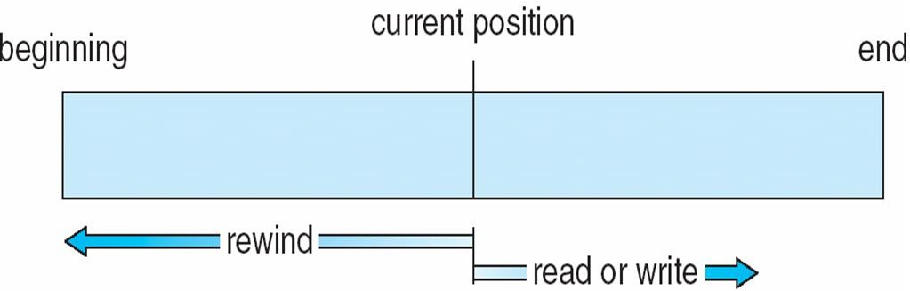
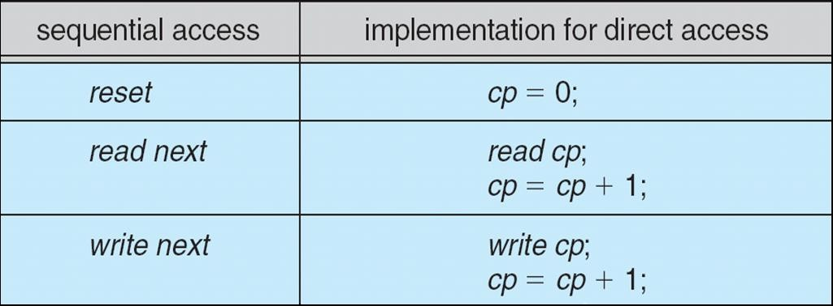
File Access Methods
Sequential Access
Commands
read_next
write_next
reset (to the beginning)
Direct/Random Access
Commands
read next
write next
read n
write n
position to n
rewrite n
(n = an index relative to the beginning of the file)

Slide 138
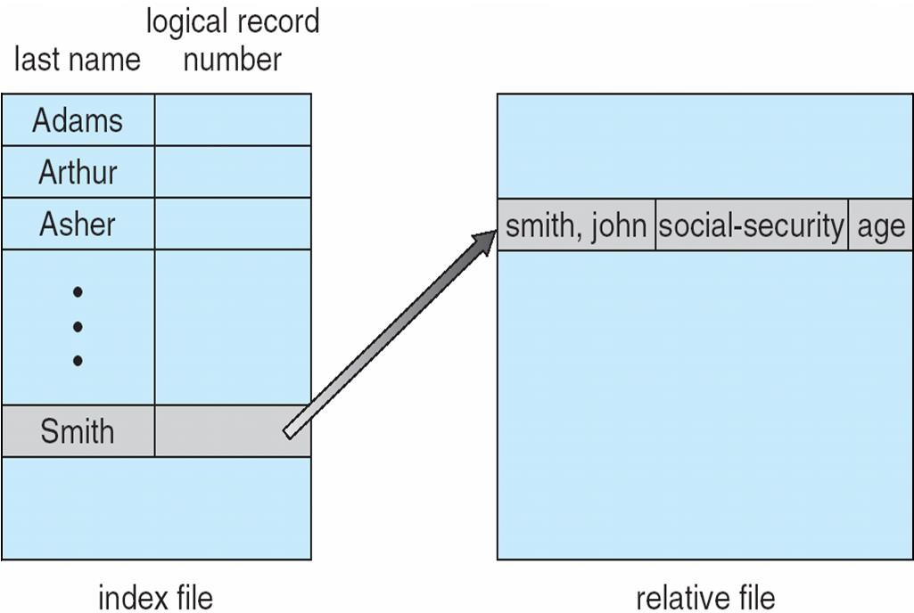
Other Access Method: Index and Relative Files
Keep index in memory for fast determination of location of data to be operated on
E.g., VMS OS

Slide 139
Directory Structure
A directory structure (per file system) is used to organize the files
Directory
Files
F 1
F 2
F 3
F 4
F n
Both the directory structure and the files reside on disk

Slide 140
Disk Structure
A drive is a physical block disk.
A drive can be subdivided into several logic block disks (partitions)
Disk or partition can be used raw, i.e., without a file system
Partition can be formatted with a file system (cooked)
Root partition contains the OS kernel, and other system files
Other partitions can hold other OSes, other file systems, or be raw.
A volume is a single accessible storage area with a single file system, a volume
can contain multiple partitions
File system types
General-purpose file systems
Mostly used, like Windows
Special-purpose file systems
E.g., Solaris’s contract file system

Slide 141
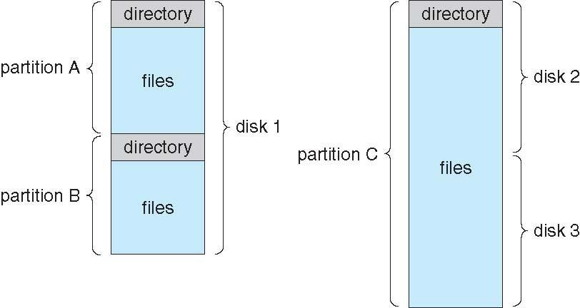
A Typical File-system Organization
A typical file-system organization

Slide 142
Operations Performed on Directory
Basic operations
Search for a file
Create a file
Delete a file
List a directory
Rename a file
Traverse the file system

Slide 143
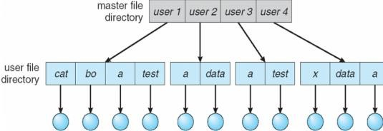
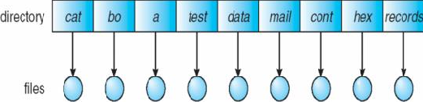
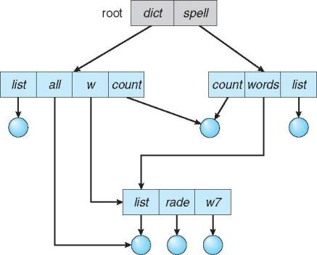

Operations Performed on Directory
The directory is organized logically to obtain
Efficient location of a file
Naming convenient to users
Two files in different directories can have the same name
The same file can have several different names
Grouping of files with similar properties
E.g., put photos in a directory
Directory organization
Single level directory
Two-level directory
Tree-structured directories
Acyclic graph directories
Thinking:
Can you tell the organizations of these four examples?
Disadvantages for single-level and two-level?

Slide 144



File System Mounting
A file system must be mounted before it can be accessed
An unmounted file system can be mounted at a mount point
The amount point must be an empty directory, i.e., original file system at the mount point must be removed if exists
mount point
(c) Mounted volume
Existing system
Unmounted volume

Slide 145
Chapter 14: File System Implementation

Slide 146
Outline
File-System Structure
File-System Operations
Directory Implementation
Allocation Methods
Free-Space Management
Efficiency and Performance
Example: WAFL File System

Slide 147
Objectives
Describe the details of implementing local file systems and directory structures
Discuss block allocation and free-block algorithms and trade-offs
Explore file system efficiency and performance issues
Describe the WAFL file system as a concrete example

Slide 148
Moving-head Disk Mechanism
One sector is one block
Disk systems typically have a well-defined block size (usually 512 bytes) determined by the size of a sector
Disk provides in-place rewrite and random access
All disk I/O is performed in units of one block (physical record) of the same size, indexed by block no. in a linear array
E.g., I/O sequence 20, 35, 11
It is unlikely that the physical record size will exactly match the length of the desired logical record
Logical records may even vary in length
Packing a number of logical records into physical blocks is a common solution to this problem

Slide 149
OS and File System
One operating system can support one or more file systems
Many operating systems allow administrators or users to add file systems
Each file system has its own format
disk file-system formats
CD-ROM and DVD file-system formats (ISO 9660)
Unix supports
Unix File System (UFS), which is based on Fast File System (FFS)
Linux supports over 130 files systems
Extended File System (Standard Linux file system)
Versions: ext2, ext3, ext4
Windows supports
Disk file formats
16 bit File Allocation Table (FAT),
32 bit File Allocation Table (FAT32),
New Technology File System (NTFS)
CD, DVD Blu-ray file system formats

Slide 150
File-System Implementation
Structures used in file system implementation
Two categories of structures
on-disk (on-storage) structures contain information about
how to boot an operating system stored in disk,
the total number of blocks,
the number and location of free blocks,
the directory structure, and
individual files
in-memory structures contain information used for
file-system management
performance improvement via caching

Slide 151

On-disk (On-storage) Structures
Volume control block
Volume details
Total # of blocks, free blocks,
block size,
free-block count and free-block pointers,
free-FCB count and FCB pointers
Ext (Linux): called superblock
NTFS (Windows): called master file table
Directory structure
Organize the files
UFS (Unix): includes file names and associated inode (same as File Control Blocks) numbers
NTFS(Windows)： File Control Blocks (FCB), called master file table
A volume: logical disk drive, perhaps a partition
Boot control block
First block of volume
Information for booting OS if OS is in this volume; otherwise empty
UFS(Unix): called boot block
NTFS(Windows): called partition boot sector
Each file has a File Control Block or inode
Unix: Indexed using inode number, includes permissions, size, dates
Windows: FCBs are stored in master file table using relational DB structures

Slide 152
In-Memory Structures
Mount table
stores file system mounts, mount points, file system types
Directory-structure cache
holds the directory information of recently accessed directories
system-wide open-file table
for all the processes
contains a copy of the FCB of each file
tracks all open files
keeps the counter of processes that have opened each file
contains process-independent information
E.g., the location of the file on disk, access dates, and file size
per-process open-file table
contains pointers to appropriate entries in system-wide open-file table
tracks all the files that a process has opened
keeps a file pointer that indicates the last read-write position of the file for each opened file
keeps file access rights

Slide 153
File Open and Close
Open a file
Search the directory structure on disk for the file and copy the content of entry （metadata） to system-wide open file table if the file is opened for the first time
Update the per-process open-file table by adding a pointer to system-wide open file table
Close a file
Remove the file entry in system-wide open file table if no process to use it any more
Update the per-process table by removing a pointer to system-wide open file table

Slide 154
Open A File
(cached)
directory structure
system-wide
open-file table
cached
File not opened
directory structure
User space
open（filename）
(2b)
(3)
Search
(1)
File found
(4)
Copy FCB
file control block
(2a)
Create an entry pointing to the entry to system-wide open-file table
File opened
On Storage
(2a:3)
(2b:5)
per-process
open-file table
In Memory

Slide 155
Allocation Methods
How disk blocks are allocated for files
Contiguous allocation(not common now)
Linked allocation (e.g. FAT32 in Windows)
Indexed allocation (e.g. ex3 in Unix)

Slide 156
Allocation Methods - Contiguous
Contiguous allocation
Each file occupies set of contiguous blocks
Each file can be located by start block # and length (total number of blocks)
E.g., A file that occupies n blocks: b, b+1, b+2, b+3, …, b+n-1
Advantages
Simple
Each to access
Minimal disk head movement
Normally on same track, or at most move to next track.
Problems
Not suitable for a file with varied size
file size must be determined at the beginning (size-declaration)
External fragmentation
Solution: compacts all free space into one contiguous space
Compaction can be done off-line (down time) or on-line
Internal fragmentation

Slide 157

Contiguous Allocation: An Example
Mapping from logical to physical
Assumption
LA: Logical Address, starting from 0
Block size: 512 bytes
Physical address
（Q + File physical start block） * 512 + R
Q: block no. relative to start
R: displacement into the block
File tr: 3 blocks in length
Starting at block 14
Quotient
Q
LA/512
Thinking:
For file tr, if a byte’s LA is 1025, what is its physical address?
R
Remainder

Slide 158
Linked Allocation: An Example
Each file is a linked list of disk blocks
Blocks may be scattered anywhere on the disk
Physical address
Rth byte in the Qth block in the list (index starts from 0)
Q: block index in the list relative to the start
R: displacement into the block
Data
pointer
A block
Quotient
Assumption
Pointer: 1 byte
Block size: 512 bytes
Thinking:
Why divided by 511?
Q
LA/511
R
Remainder

Slide 159

Linked Allocation
Thinking:
For the file jeep, if LA is 512, what is its physical address?

Slide 160

Allocation Methods – Linked Allocation Variation
File Allocation Table (FAT)
An important variation on linked allocation used in MS-DOS
Indexed in physical block no.
Each entry stores the no. of next block for this file
Like a linked list, but faster on disk and cacheable
Simple and efficient
File test consists of disk blocks: 217, 618, 339.
Number of physical blocks -1

Slide 161
Allocation Methods – Indexed Allocation
Indexed allocation
Bring all the pointers together into the index block(s)
Each entry points to a block in a file
Each file has its own index block(s) of pointers to its data blocks
Advantages
Random access
No external fragmentation
Disadvantages
Extra space for index table, more
waste space than linked allocation
Pointer to
Data block
Data block
Data block
Data block
Index block(s)
An index table

Slide 162

Example of Indexed Allocation
Assumption
Pointer: 1 byte
Block size: 512 bytes
Thinking:
For the file jeep, if LA is 513, what is its physical address?
For a file has size 256K, how many blocks are used as index block?
Indexed allocation of disk space

Slide 163
A Comparison Table
 | Contiguous allocation | Linked allocation | Linked Allocation(FAT) | Indexed allocation
allocation | contiguous | scattered | scattered | scattered
Directory hold information | For each file: file name, start block, number of blocks | For each file: file name, start block, end block. Linked through pointer | For each file: file name, start block One volume table indexed by block no. including next block no. Linked through block no. | For each file: Index block no Index block: Pointers to data blocks
Direct access support | Yes | No | Yes (Partial) | Yes
fragmentation | External, internal | Internal | Internal | Internal
Overhead | No | Pointer | FAT | Index block
File size declaration | Necessary | Not necessary | Not necessary | Not necessary

Slide 164
Indexed Allocation – Schemes in Handling Large Files
One index block is not enough for large files
Three schemes to solve this issue
Linked scheme
Multilevel index
Combined scheme

Slide 165
Free-Space Management
File system need to track available (free) blocks
Approaches
Bit vector (map)
Linked list
Grouping
Counting

Slide 166
Efficiency and Performance
The efficient use of storage device space depends on
disk allocation method
Contiguous, Linked, and Indexed
directory structure / algorithms
types of data kept in file’ s directory entry
allocation of metadata structures
fixed-size or varying-size data structures
e.g. the open file tables
Ways to improve efficiency and performance
Keep data and metadata close together (for hard disk, but not SSD)
Use buffer cache for quick access
Use asynchronous writes
No need to write to disk immediately
Use Trim mechanism
Keep the unused blocks for writing
No need to do garbage collection and erase steps before the device is nearly full

